Slide 1
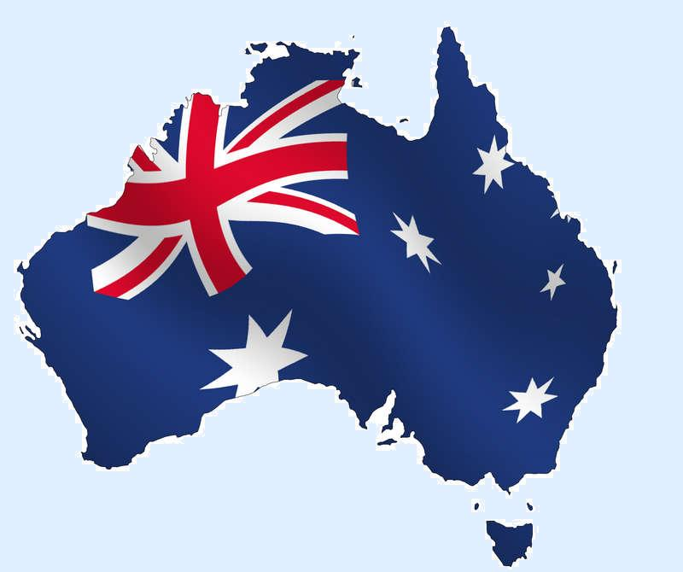
Australia
11.ny
Made by: Viktória Guba, Laura Kucsera and Martin Rittmann

Slide 2
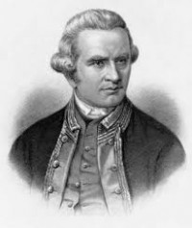
Discovering Australia
James Cook during his first exploration was discovered the Australian island with New Zealand in 1770. He travelled around the new continent.
But not he was the only who came to Australia. In the 15th century there were Chinese, Spanish,Portugese and Holland explorers. The natives who live in the island called ‘aborigals’ were supressed by the Europan people.

Slide 3
Aboriginals
Aboriginals are still in tribes. They use boomerangs and shields to hunt and fight. Aboriginals live nomad life in the jungle and they are always naked because the they can get closer to the nature.

Slide 4
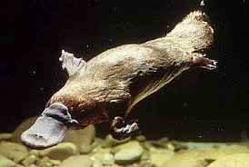
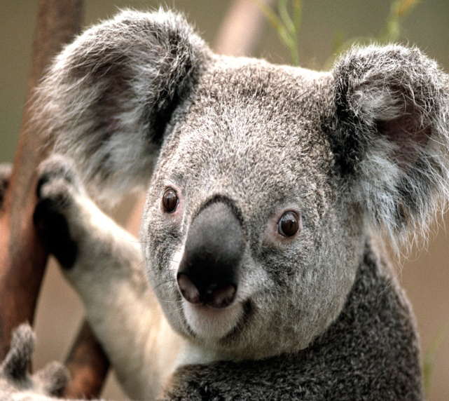
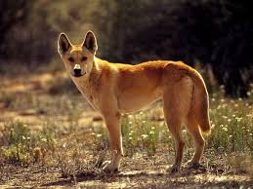
Animals-Wildlife
Kengurues and koalas are the most famous animals and they are the first when the people think of the wildlife of Australia.But the platypus and the dingo dogs are live there too.

Slide 5
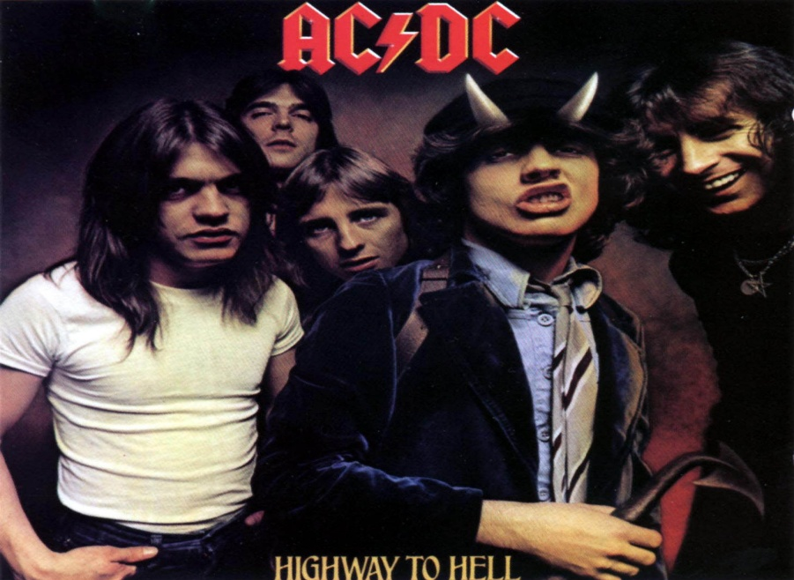
Musician
Everyone knows the AC/DC rock band which was established in 1973 and it was the most popular band in the 1980s.It was founded by Malcolm and Angus Young.
Kylie Ann Minogue comes from
Australia too.

Slide 6
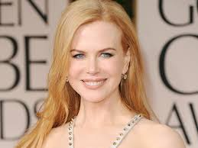
Celebrities
Russel Crowe
Hugh Jackman
Nicole Kidman

Slide 7
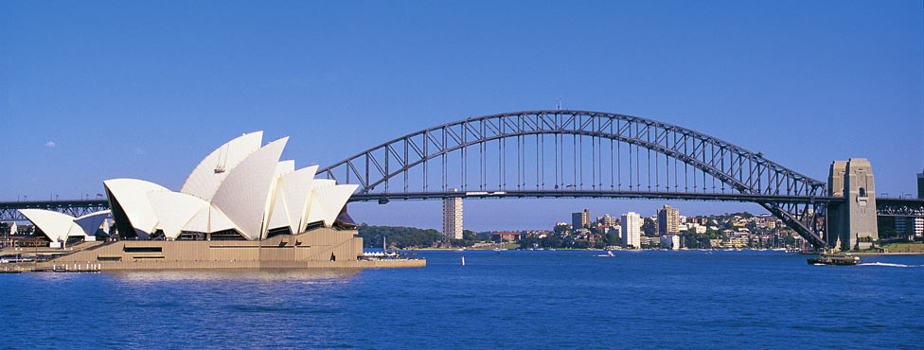
Famous places in Australia
When the people think of Australia the first is comes to their mind is Sydney. Sydney is most populous city of Australia and it’s a global city. The Opera House is next to the beach and behind it there’s the Sydney Harbour Bridge.
Sydney is the most
fashionable city.
This town holds the
biggest outdoor
and free New Year’s
Eve.

Slide 8
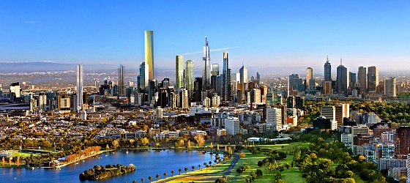
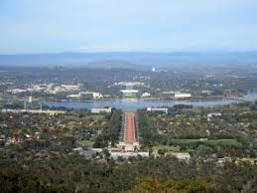
Other places
Capital city
Canberra’s population is about 358.000 people.
The Parliament House,the australian government and the national Museum are there.
Melbourne
Melbourne is the capital city of Victoria State.
The Summer Olimpyc Games were held in 1956 in this city.
The Melbourne Grand Prix Circuit is a racing track and the Formula 1 car races were sorted here.

Slide 9
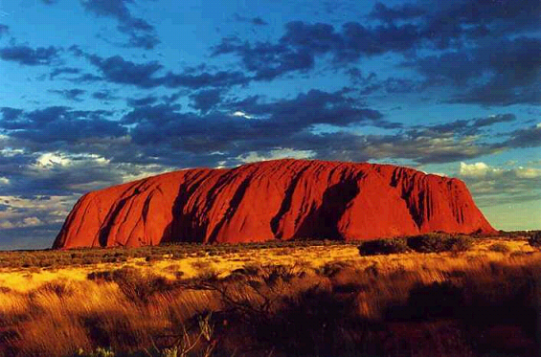
Natural Values of Australia
The Great Barrier Reef is the world's largest coral reef system and it can be seen from outer space and is the world's biggest single structure made by living organisms.
The Ayers Rock ( Uluru) is a large sandstone rock. It is listed as a UNESCO World Heritage Site.

Slide 10
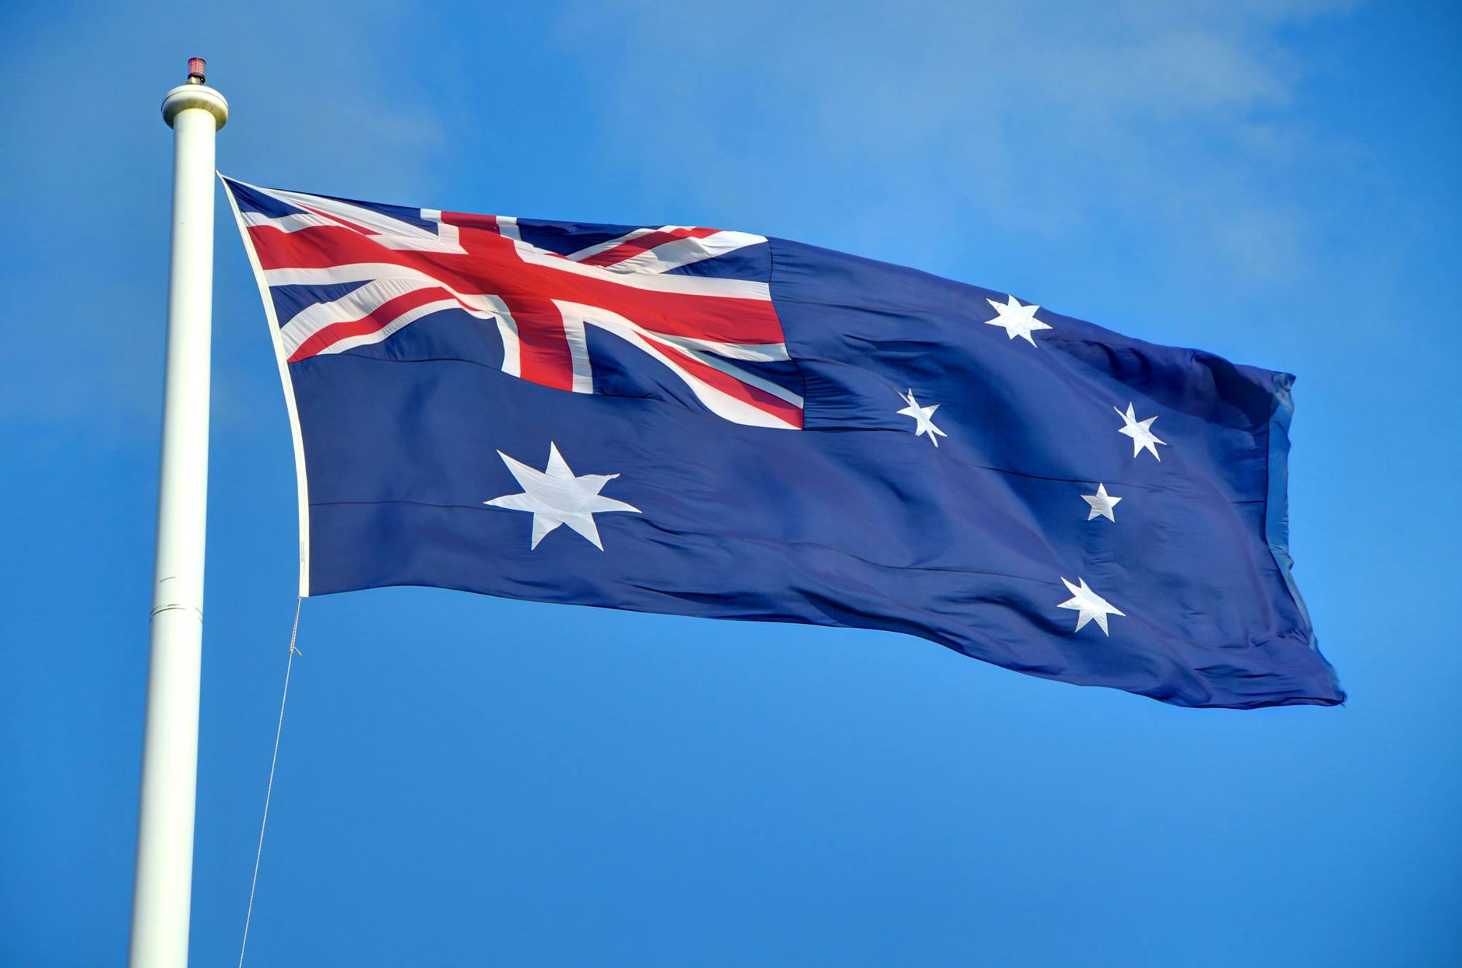
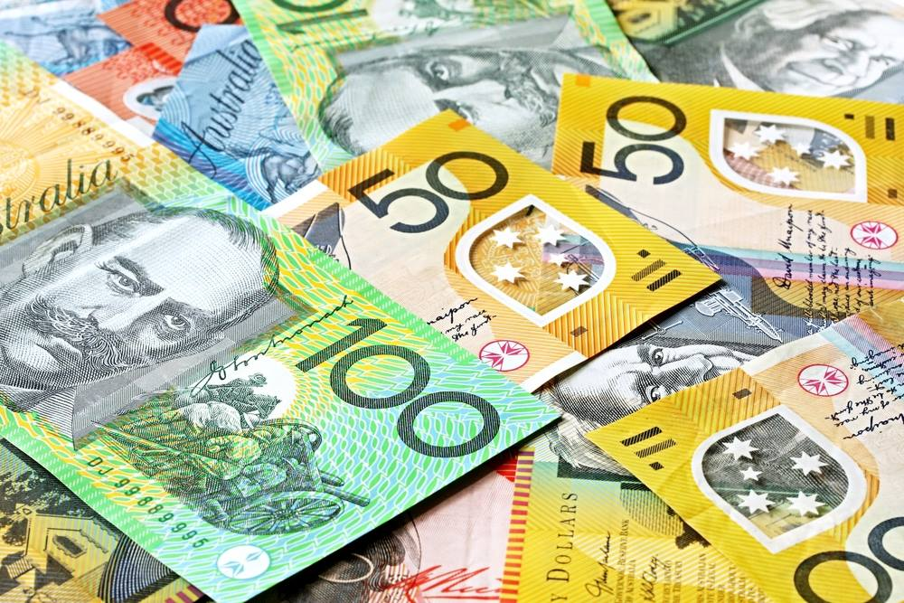
Flag
Golden Wattle
Money

