Slide 2
Australia is situated south of Asia, between the Pacific and the Indian Oceans. Australia is a continent, a country and an island at the same time. Australia is located in the southern hemisphere.

Slide 3
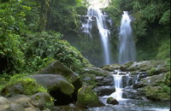
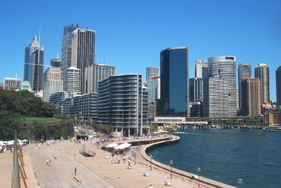
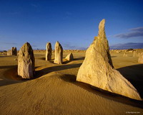
Some facts
OFFITIAL NAME : Commonwealth of Australia
CAPITAL: Canberra
TOTAL AREA: 7,700,000 sq.km
POPULATION: 20 million people
HEAD OF STATE: Queen Elizabeth II represented by Governor-General
FORM OF GVERNMENT: Constitutional monarchy
PORTS: Sydney, Melbourne, Brisbane
LONGEST RIVER: the Darling (2,740 km)
HIGHEST POINT: Mount Kosciusko (2,230 m)
NATURAL RESOURCES: coal, zink, nickel, gold, wool
NATIONAL HOLIDAY: Australian Day , 16 January (1788)
MONEY: basic unit – Australian dollar
NATIONAL SYMBOLS: Kangaroo and Emu
NATIONAL ANTHEM: “Waltzing Matilda”

Slide 4
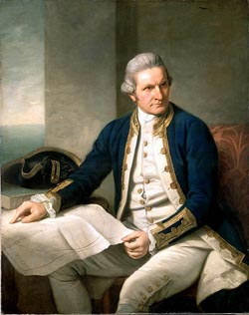
Captain James Cook discovered Australia in 1770. He was sent to discover the huge land that many people believed was south of the equator. He landed south of present day Sydney in New South Wales. He claimed this part of the land for the King of England.
In 1851 gold was discovered about 300 km west of Sydney. People rushed to the gold fields to find their fortunes. This attracted robbers called bushrangers.

Slide 5
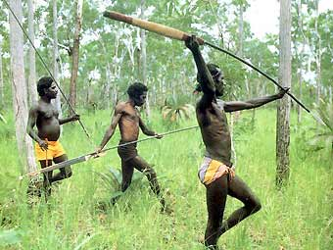
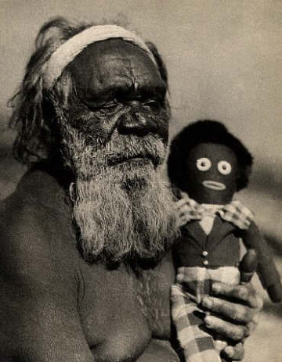
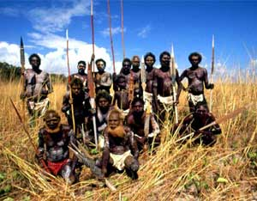
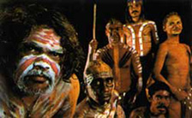
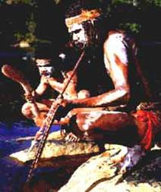
Aborigines
The Aborigines are the Australian natives that had been living there for thousands of years before the first Europeans came to Australia in the 1600s.

Slide 6
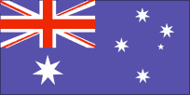
The flag of Australia is the only one to fly over a whole continent. The small Union Jack represents the historical link with Britain, the large seven-pointed star represents the six States and Territories, and the small stars from the Southern Cross – a prominent feature of the southern hemisphere night sky.
Australia's coat of arms – the official emblem of the Australian Government – was granted by George V in 1912. The arms consist of a shield containing the badges of the six states. The supporters are native Australian fauna – a kangaroo and an emu. A yellow-flowered native plant, wattle, also appears in the design.

Slide 7
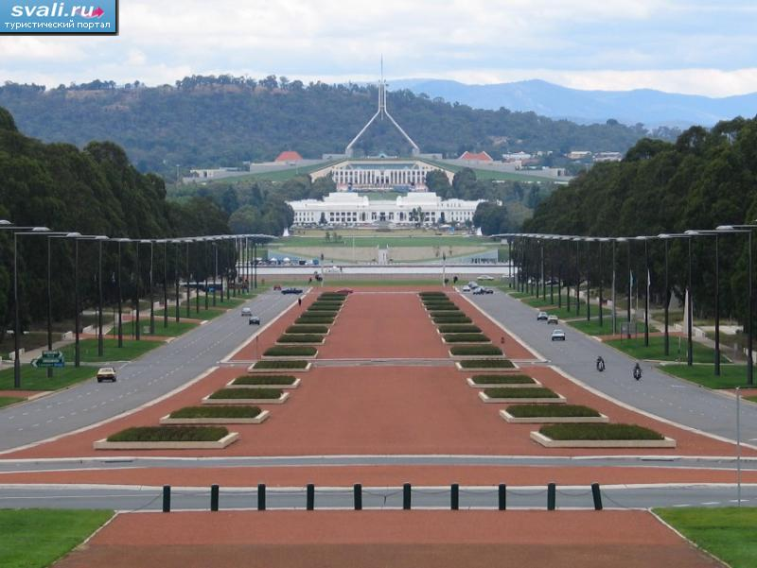
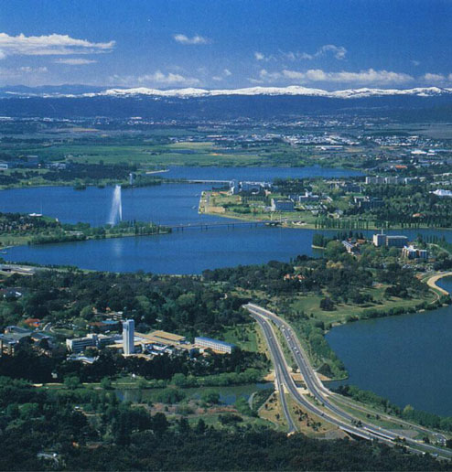
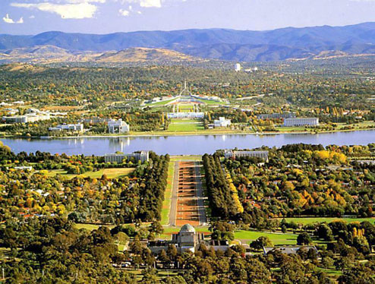
Canberra is the capital of Australia. It is very young city.
Population is about 310,000 people.
Capitol Hill
Canberra Fountain

Slide 8
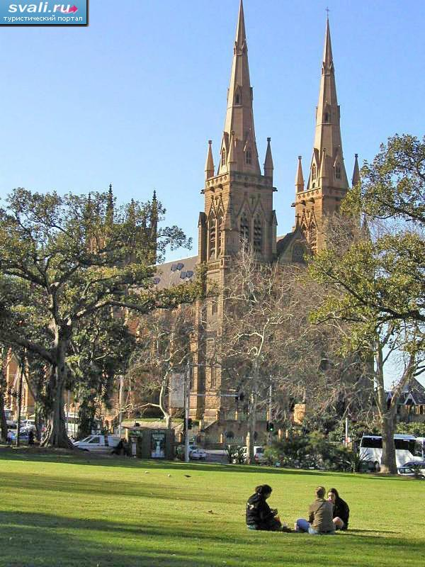
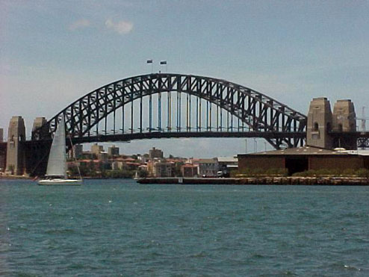
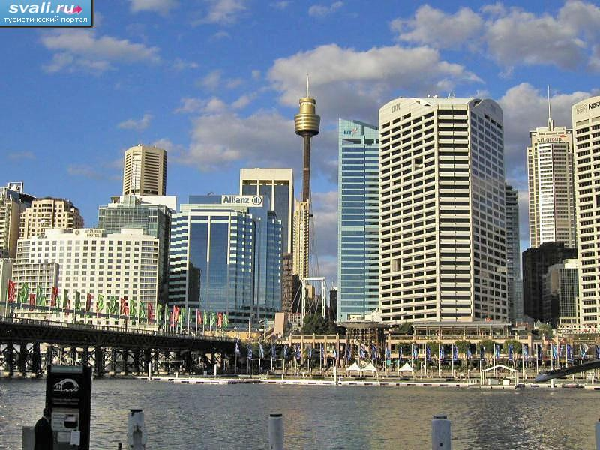
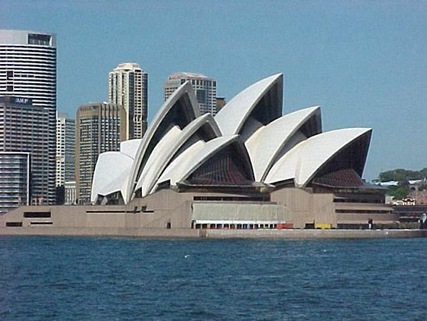
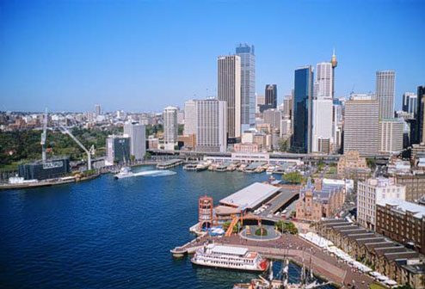
Sydney
Capital of New South Wales. Leading industrial city. Population: 3,200,000 people.
Sydney AMP Tower
St. Maria Cathedral
The Harbour Bridge
Sydney
Opera House

Slide 9
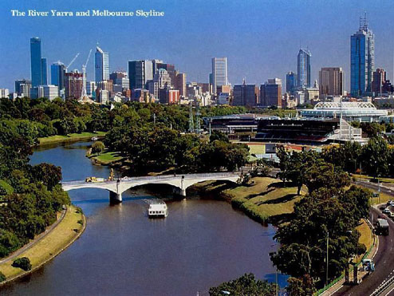
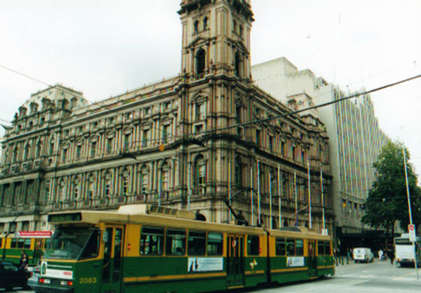
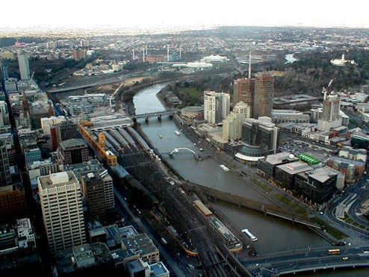
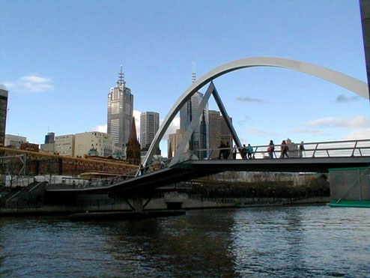
Capital of Victoria. The world’s most livable city. Population: 3.200.000
Old House
Melbourne
Melbourne Bridge
Train Station

Slide 10
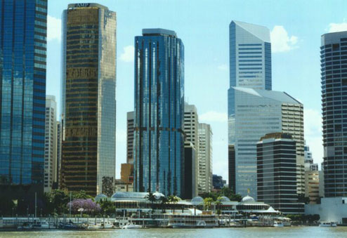
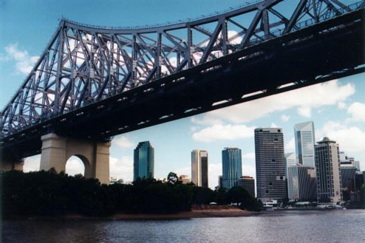
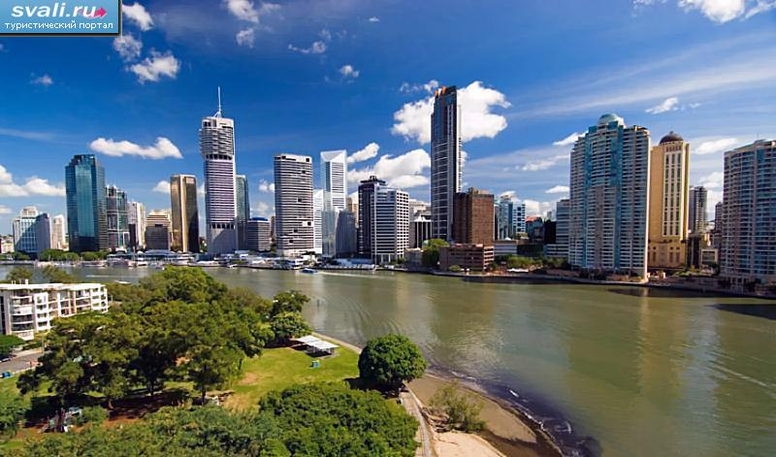
Capital of Queensland. It is a year-round vocation place. Population is about 1,400,000 people.
Brisbane
Brisbane Skyscrapers
Brisbane Bridge
Brisbane

Slide 11
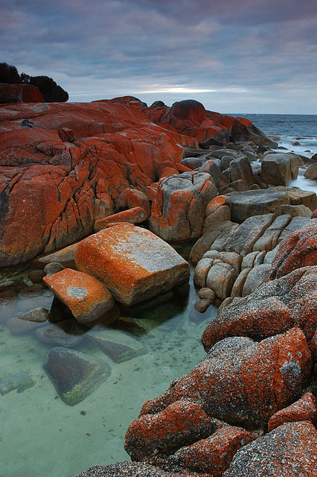
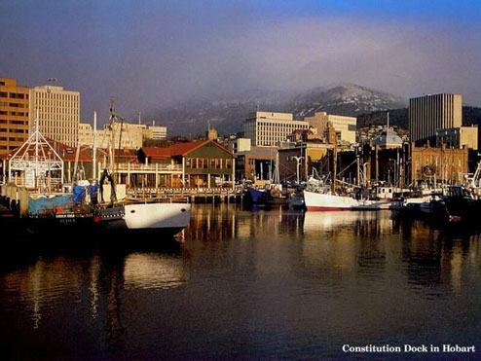
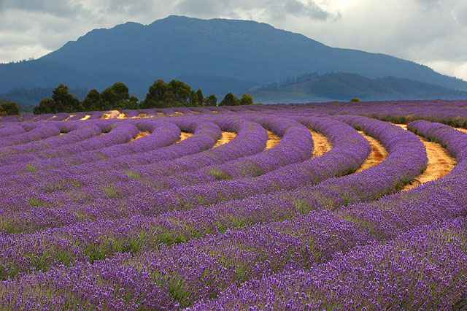
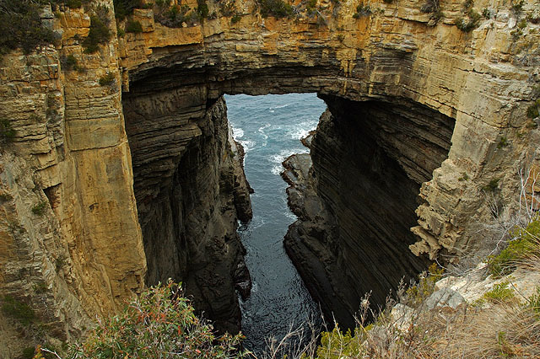
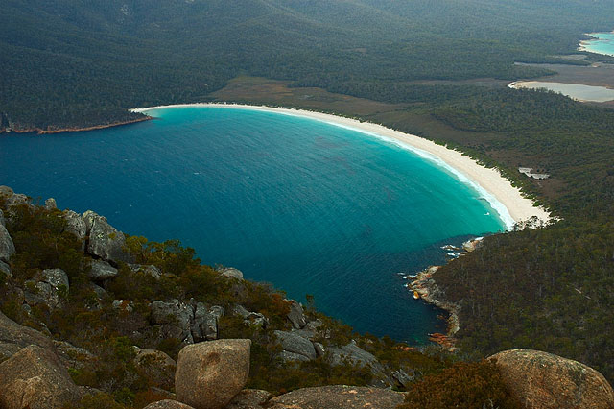
Capital of island-state Tasmania. Winters are very cold. Population of about 200,000.
Bay of Fires
Hobart
Lavender Farm
Remarkable Cave
Coles Bay

Slide 12
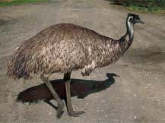
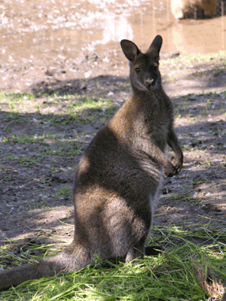
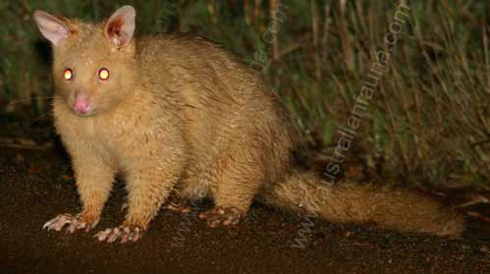
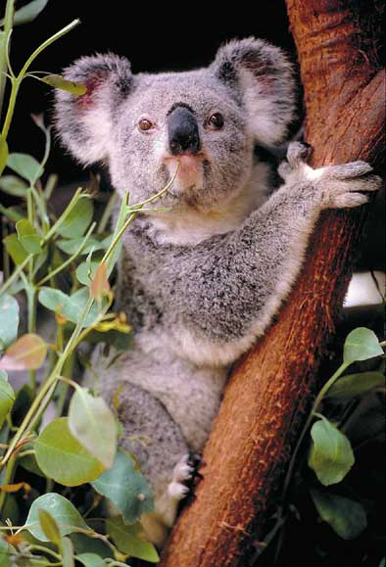
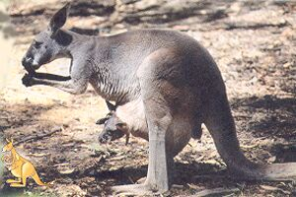
Australians really love nature. They try to protect their nature and their animals.

Slide 13
ThX
for watching

