Slide 1
Australia
The diverse continent

Slide 2
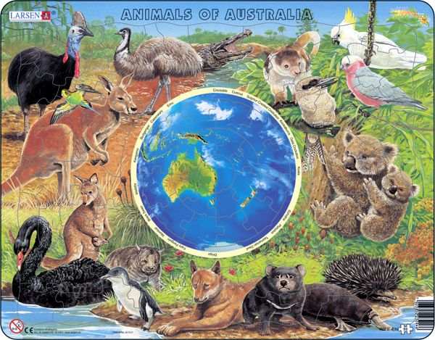

Slide 3
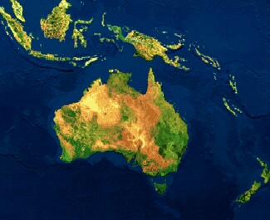
Australias an Oceanian country
Australia officially the Commonwealth of Australias an Oceanian country comprising the mainland of the Australian continent, the island of Tasmania, and numerous smaller islands. It is the world's sixth-largest country by total area. Neighbouring countries include Indonesia, East Timor and Papua New Guinea to the north; theSolomon Islands and Vanuatu to the north-east; and New Zealand to the south-east.

Slide 4
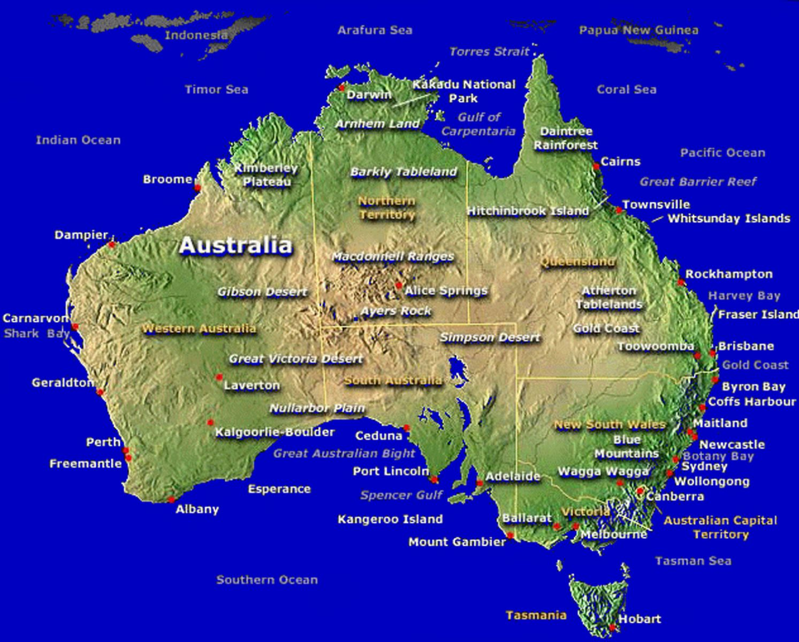
Goverment of Australia
Australia is a constitutional monarchy with a federal division of powers. It uses a parliamentary system of government with Queen Elizabeth II at its apex as the Queen of Australia, a role that is distinct from her position as monarch of the other Commonwealth realms.

Slide 5
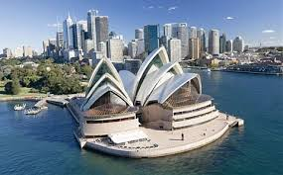
Sydney
Sydney is the state capital of New South Wales and the most populous city in Australia and Oceania. Located on Australia's east coast, the metropolis surrounds one of the world's largest natural harbours, and sprawls towards the Blue Mountains to the west. Residents are together known as "Sydneysiders" and constitute the most multicultural city in Australia and one of the most multicultural cities in the world.

Slide 6
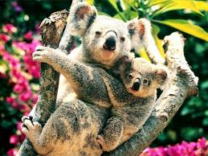
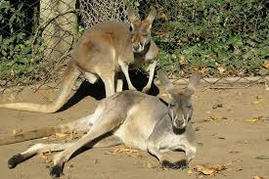
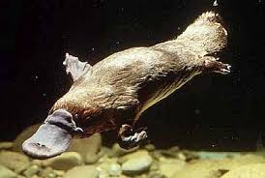
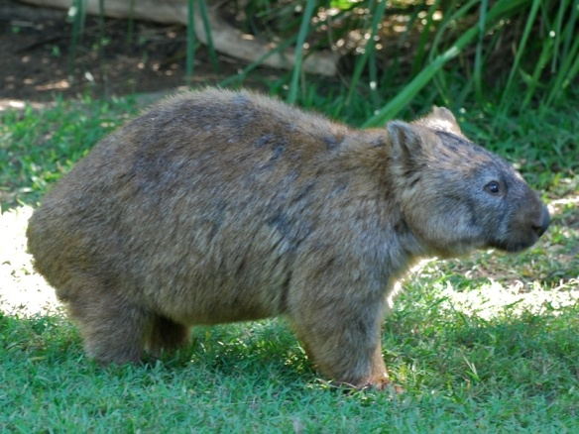
Animals of island
Australia has a unique flora and fauna is, settled down in the small marsupials : the common wombat, Australia is a whole continent , the vast expanse of wilderness areas. A total of 560 national park in the federal and state management

Slide 7
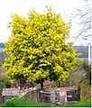
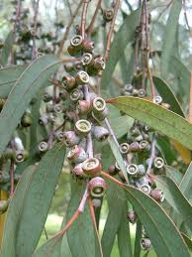
Flora
Rain forests , deserts and groves have a variety of plants , such as eucalyptus , ferns , dragon's blood tree
Australia is a whole continent , the vast expanse of wilderness areas. A total of 560 national park in the federal and state management

Slide 8
The End
See you in Australia

