Slide 1
Ausztrália

Slide 2
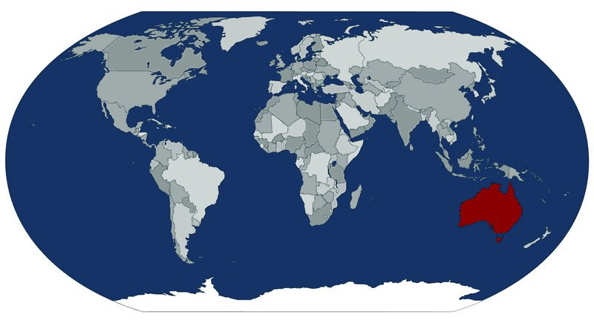
Location
Prime meridian
Eastern hemisphere
Tropic of Cancer
Equator
Tropic of Capricorn
Southern Hemisphere

Slide 3
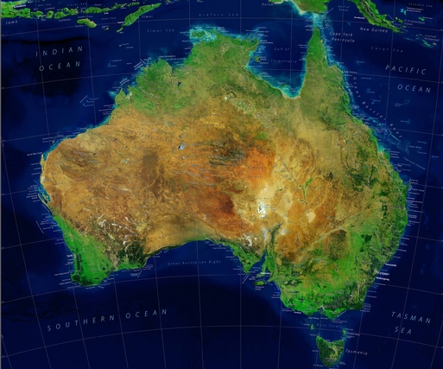
Borders and coastline
York Peninsula
Pacific
Great Australian Bay
Indian Ocean
Tasmanian Island

Slide 4
Surface of landscapes
Australian table
Australian table
This ancient land board
Fault block Óidei
New Time Quaternary plain
Australian Plain

Slide 5
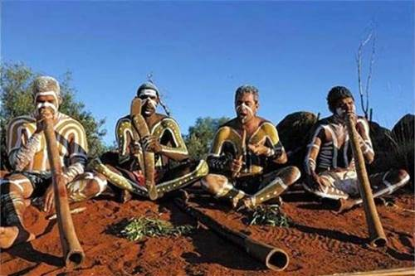
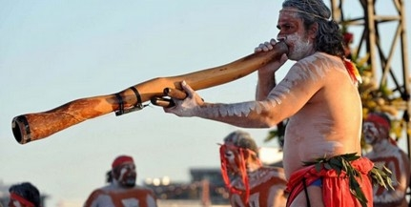
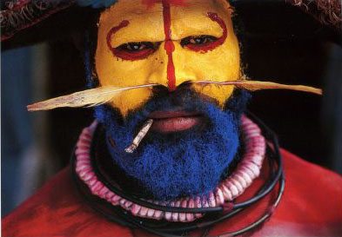
Australian aborigines

Slide 6
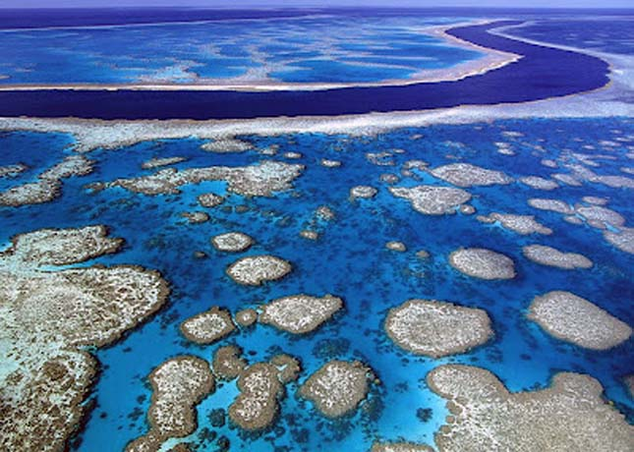
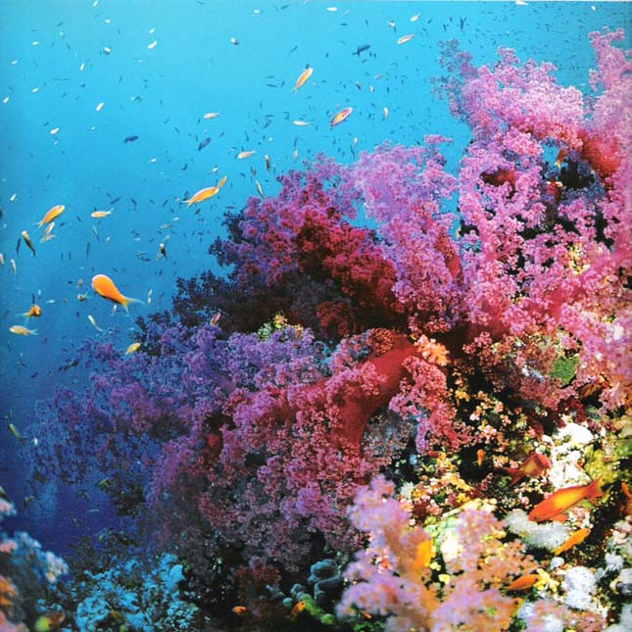
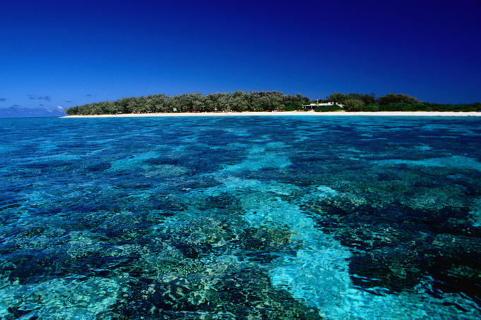
Great Barrier Reef

