Slide 1
Australia

Slide 2
Australia,the versatile continent/country
Australia is oldest,driest,smallest and the last discovered continent(and country!) in the world.There are a lot of special animal and plant species here.
What do you need to know about this continent?
The capital of Australia is Canberra.
Anthem:Advance Australia Fair
Head of state : II.Elisabeth Australian queen
Governol General: Peter John Cosgrove
Prime minister: Tony Abott
Official language : English
Population: 23 572 400 (2014 July)
Area:7 741 220 km2

Slide 3
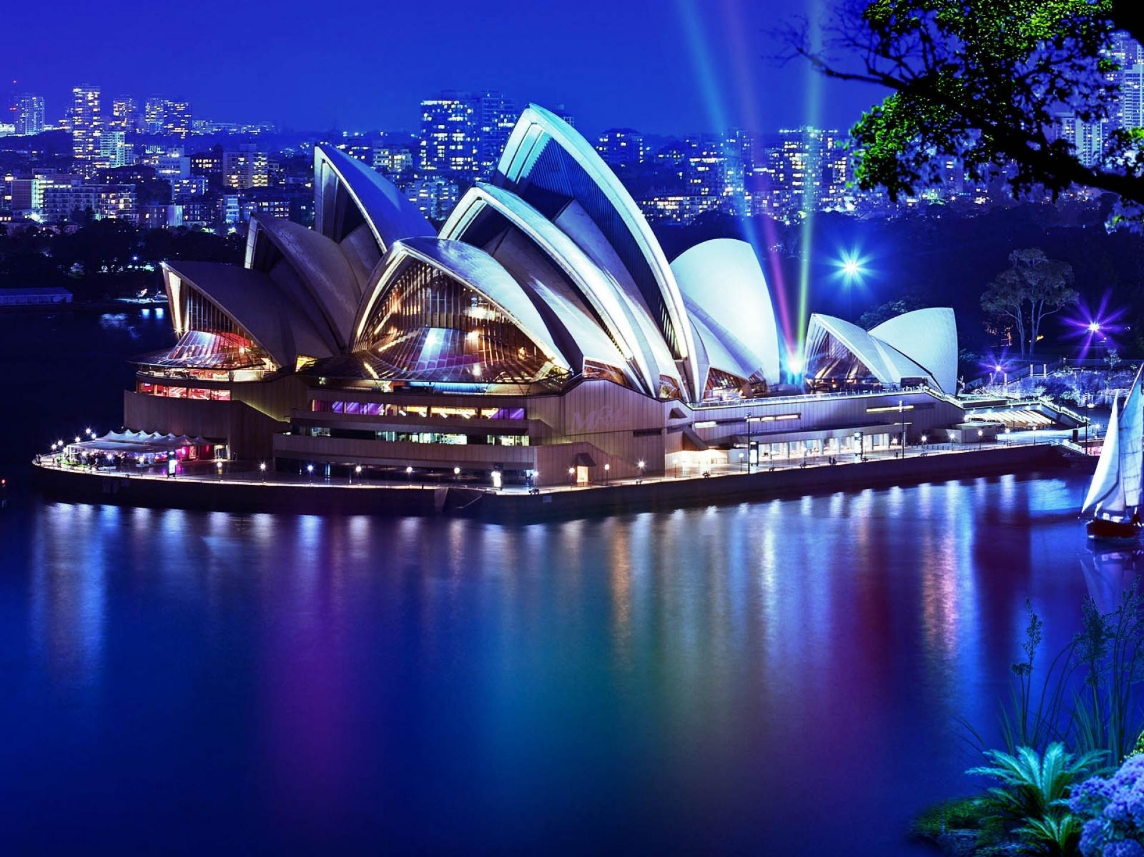
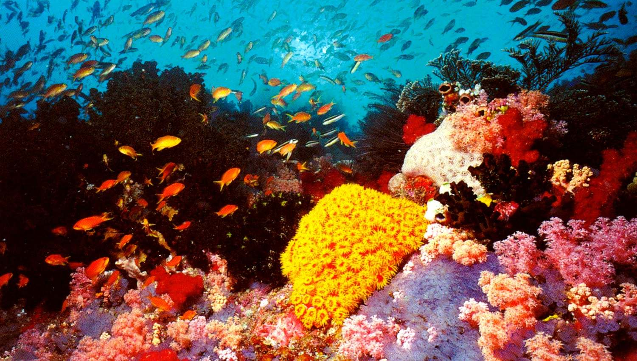
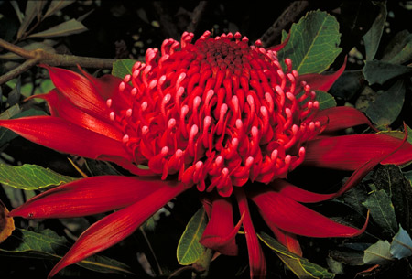
Australia’s sights
The opera house of Sydney
Coral reef
Plants

Slide 4
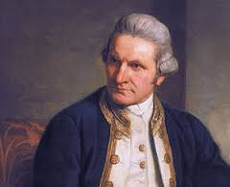
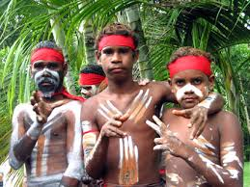
History
James Cook Captain Discovered Austraia in 1770.
Native Australians called the Aborigines have lived in Australia for over 40,000 years.Now they only represent 1% of the population. The total population of Australia is 22 million.
James Cook Captain Discovered Austraia in 1770.
The British decided to use the land as a prison colony. Britain needed a place to send its convicts because its prisons were full and it had just lost its American colonies in the American War of Independence.

Slide 5
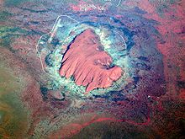
Geography
Uluru is one of Australia's most recognisable natural landmarks.
Is a large sandstone rock formation in the southern part of the Northern Territory in central Australia.
Uluru is notable for appearing to change colour at different times of the day and year, most notably when it glows red at dawn and sunset.
The sandstone formation stands 348 m high, rising 863 m above sea level with most of its bulk lying underground, and has a total circumference of 9.4 km.

Slide 6
Thank you for visiting Australia !

