Slide 1
Welcome to Australia
Australia is situated south of Asia, between the Pacific and the Indian Oceans. Australia is a continent, a country and an island at the same time. Australia is located in the southern hemisphere.
Capital city: Canberra
Official name: Commonwealth of Australia

Slide 2
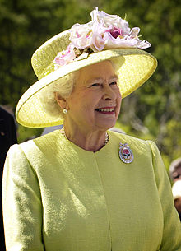
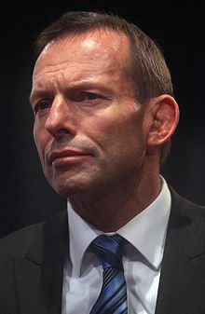
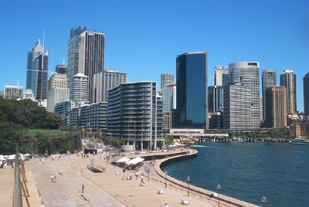
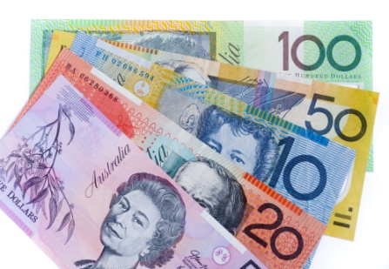
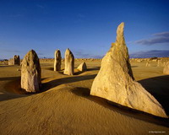
Some facts
Total area: 7.692.024 km²
Sixth-largest country by total area.
Population: 23. 110.916 people.
Head of state: Queen Elizabeth II represented by Governor-General
28th Prime minister: Tony Abbott
Form of Government: Australia is a constitutional monarchy with a federal
division of powers.
Natural resources: Australia is rich in mineral resources, notably bauxite, coal, diamonds, gold, iron ore, mineral sands, natural gas, nickel, petroleum, and uranium. Readily cultivable farmland is at a premium because much of the land is desert.
National language: English
National holiday: Australian Day , 16 January (1788)
National symbols: Kangoroo and Emu
National anthem: “Waltzing Matilda”
National money: Australian dollar.

Slide 3
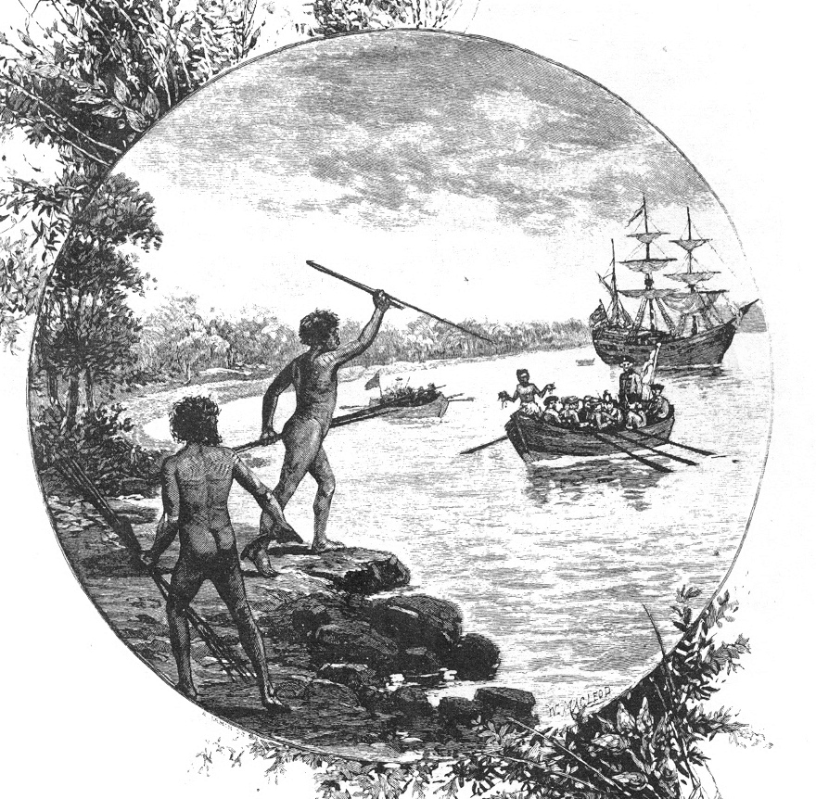
History
Discovered by the Dutch in the early 1600’s.But it was Englishman James Cook who claimed Australia for Britain in 1770.
Britain 1st used the country as a penal colony and a total of 160,000 people came to Australia as convicts.
Europeans sold the land of Aborigines and killed thousands of them to claim land.
Finally in 1901 that the whole of Australia came under 1 constitution.

Slide 4
Education and Health Care
School is Compulsory from ages 5-16 years old.
16-17 required to attend school or participate in some kind of vocational training.
TAFE -Australia is among one of the most expensive places to attend University.
Australia has the fourth highest life expectancy in the world after Iceland, Japan and Hong Kong. Life expectancy in Australia in 2010 was 79.5 years for males and 84.0 years for females.

Slide 5
The first Australians
The First people in Australia were Aborigines. They arrived there about 12,000 years before from southern Asia. They had very rich forms of art, painting, song, poetry and mythology. The lives of aborigines stayed almost the same for thousands of years until the Europeans came to live in Australia in 1778.
The Europeans suffered a lot in Australia but the Aborigines suffered a lot more. Europeans stole their land and killed thousand of Aborigines. They also brought new diseases with them. In parts of Australia, not one Aborigine survived. Today aborigines continue to live in Australia but there culture in under threat. In 1770, there were about 300,000 Aborigines. Now, there are 120,000. It is becoming harder and harder for them to continue their traditional way to live.
Today Australia is a modern, industrial country, independent from Britain since 1931. The Commonwealth of Australia consists of 6 states and two provinces. It is the world’s biggest producer of wool, bauxite and important producer of wheat, meat, sugar and fruit.

Slide 6
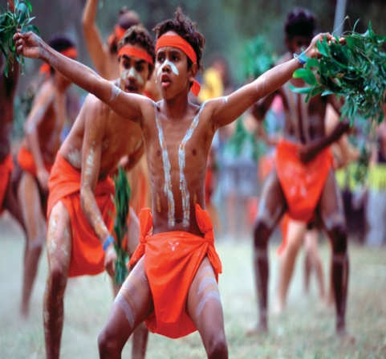
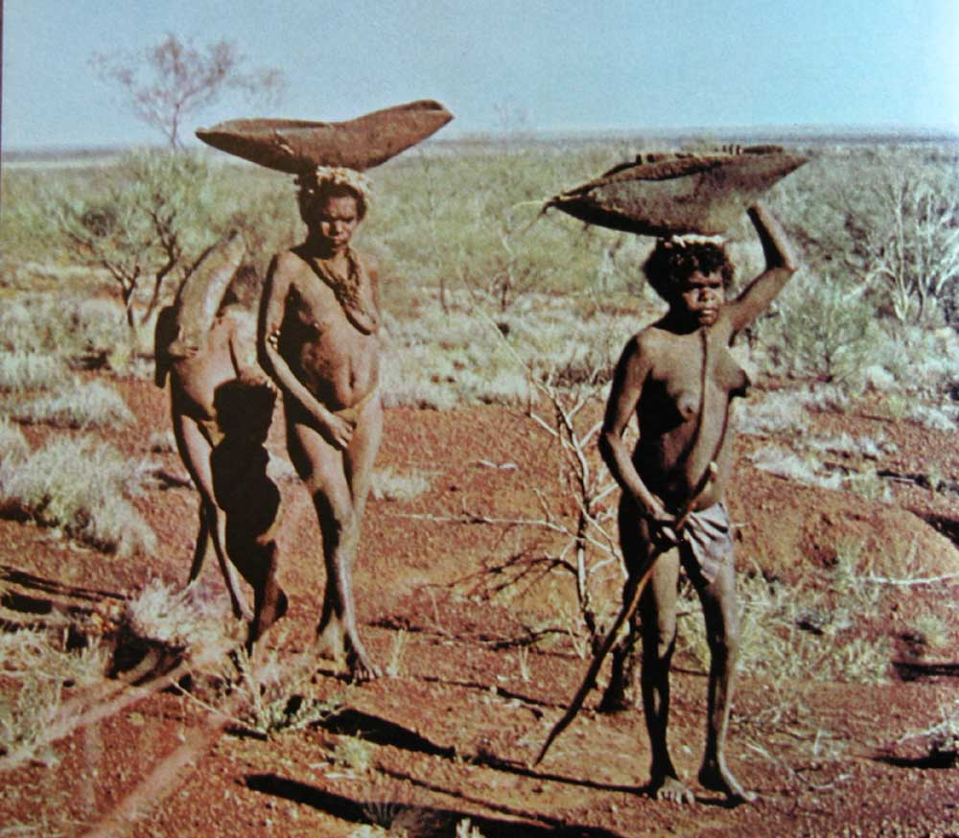
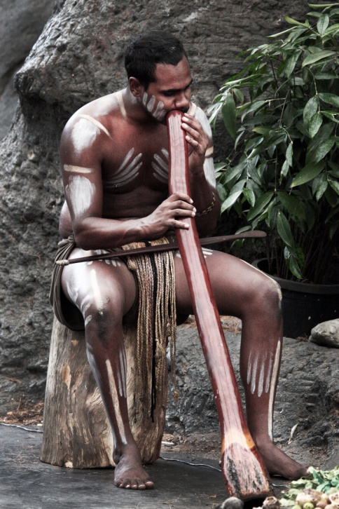
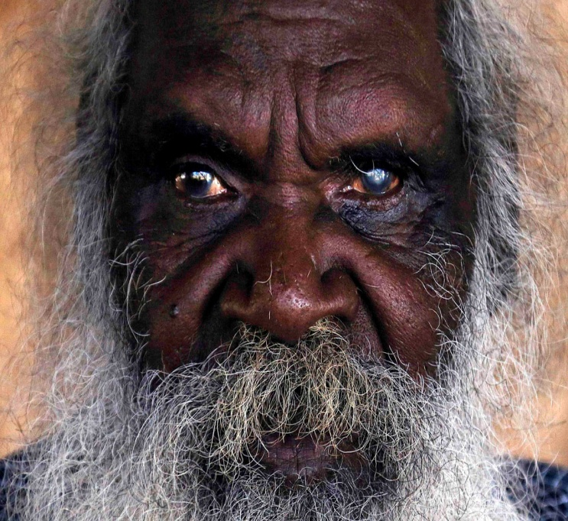
A
U
S
T
R
A
L
I
A
n
A
B
O
R
I
G
I
N
A
l
The Aborigines are the Australian natives that had been living there for thousands of years before the first Europeans came to Australia in the 1600s. People scattered across the continent living as hunters and gatherers. 300 clans, 250 languages and 700 dialects.

Slide 7
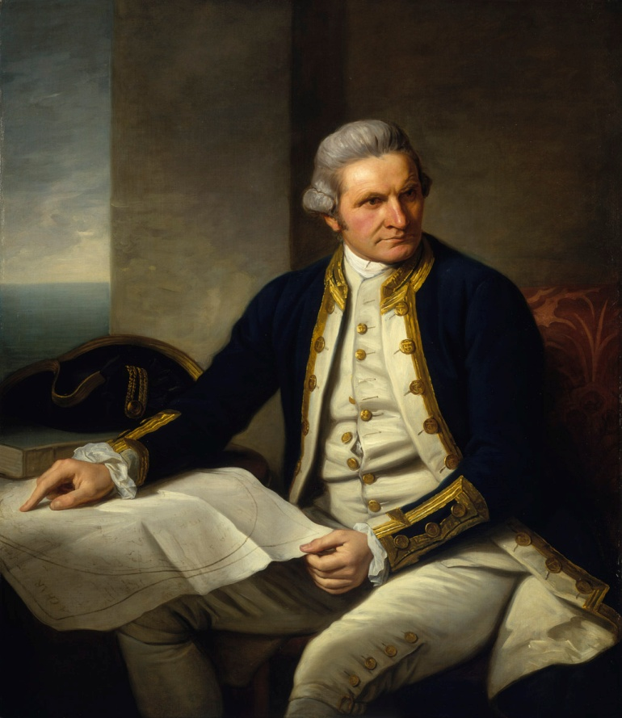
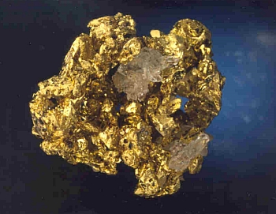
Captain James Cook discovered Australia in 1770. He was sent to discover the huge land that many people believed was south of the equator. He landed south of present day Sydney in New South Wales. He claimed this part of the land for the King of England.
In 1851 gold was discovered about 300 km west of Sydney. People rushed to the gold fields to find their fortunes. This attracted robbers called bushrangers.

Slide 8
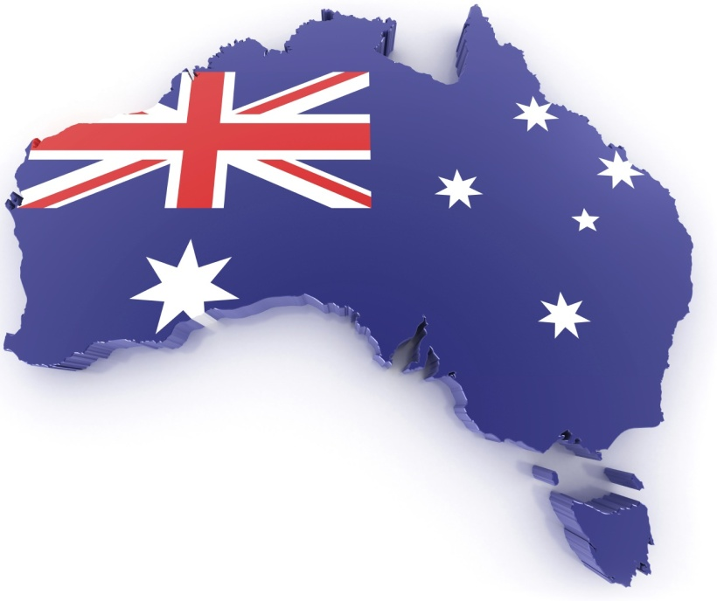
Australia's coat of arms – the official emblem of the Australian Government – was granted by George V in 1912. The arms consist of a shield containing the badges of the six states. The supporters are native Australian fauna – a kangaroo and an emu. A yellow-flowered native plant, wattle, also appears in the design.
The flag of Australia is the only one to fly over a whole continent. The small Union Jack represents the historical link with Britain, the large seven-pointed star represents the six States and Territories, and the small stars from the Southern Cross – a prominent feature of the southern hemisphere night sky.
Southern cross symbolizes the constellation.
The Commonwealth 7 pointed star represents the 7 territories.

Slide 9
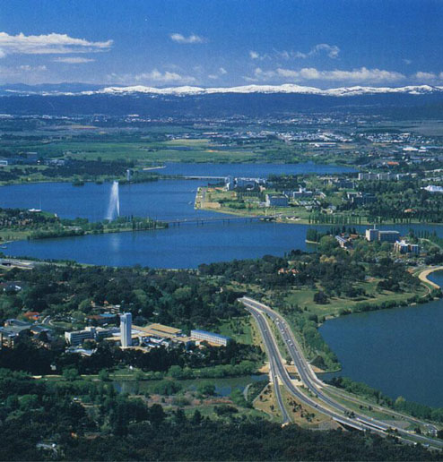
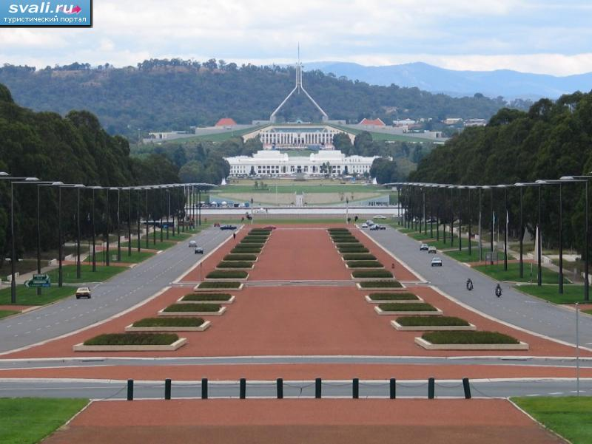
Canberra
Canberra is the capital of Australia. It is very young city.
Population is about 310,000 people.
Canberra Fountain
Capitol Hill

Slide 10
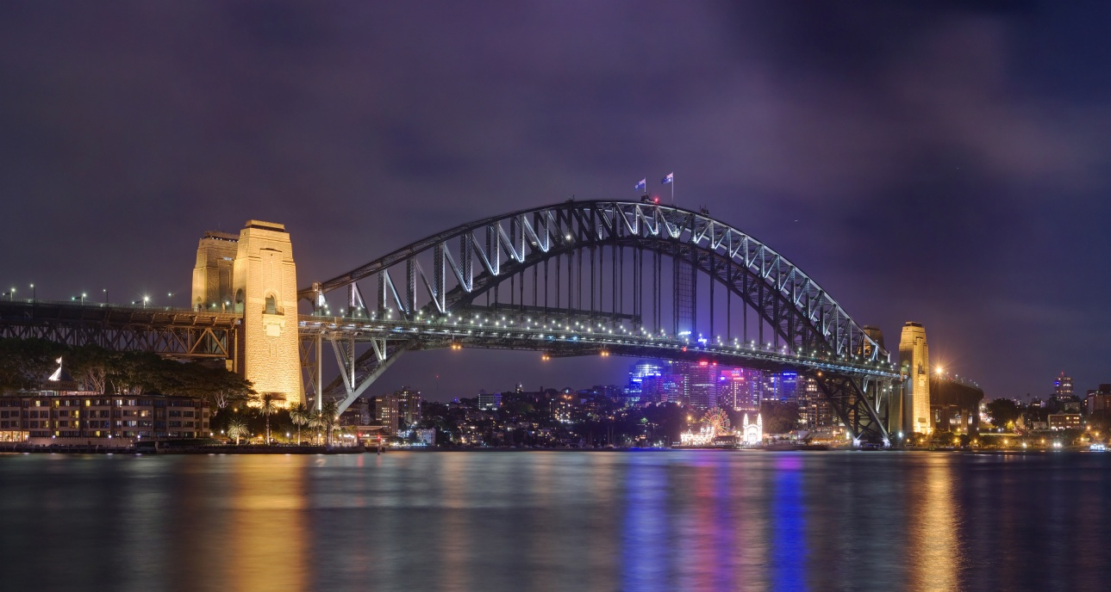
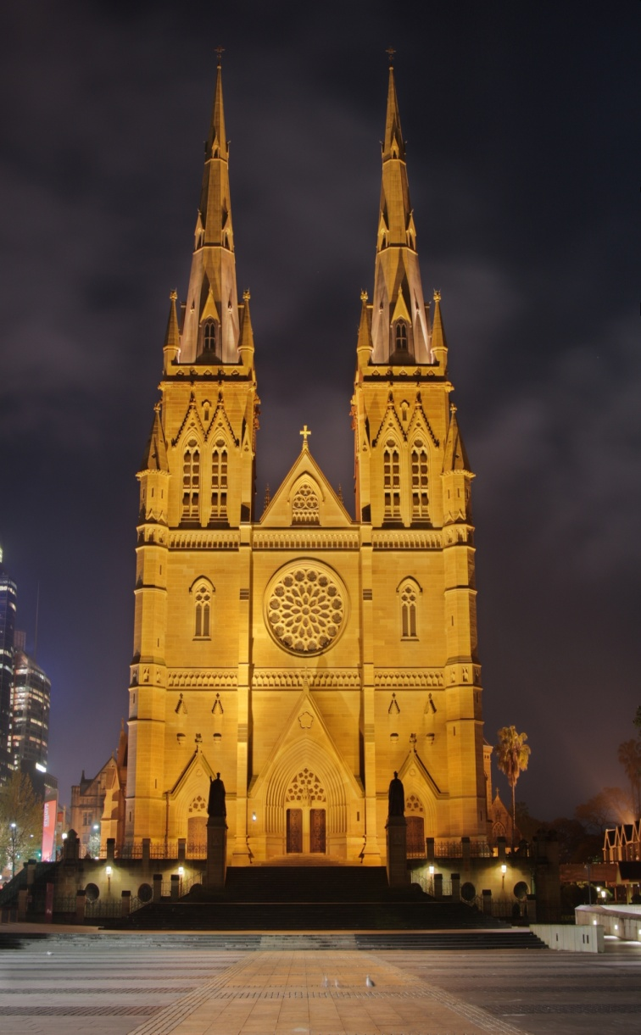
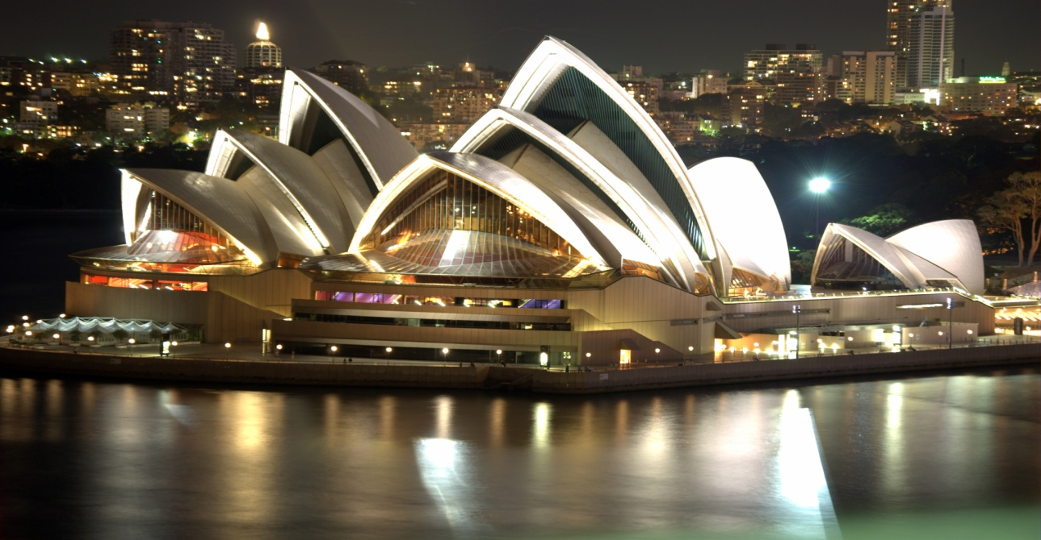
Sidney
The Sydney Harbour Bridge is a steel through arch bridge across Sydney Harbour that carries rail, vehicular, bicycle, and pedestrian traffic between the Sydney central business district and the North Shore.
The Metropolitan Cathedral of Saint Mary is the cathedral church of the Roman Catholic Archdiocese of Sydney and the seat of the Archbishop of Sydney
The Sydney Opera House is a multi-venue performing arts centre in Sydney, New South Wales, Australia.

Slide 11
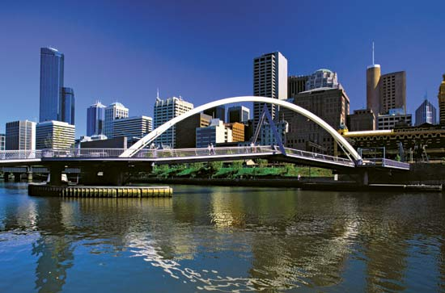
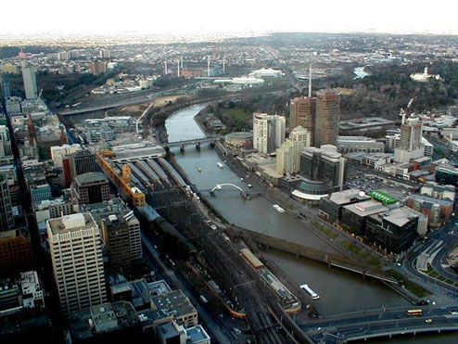
Melbourne Bridge
Melbourne
Train Station

Slide 12
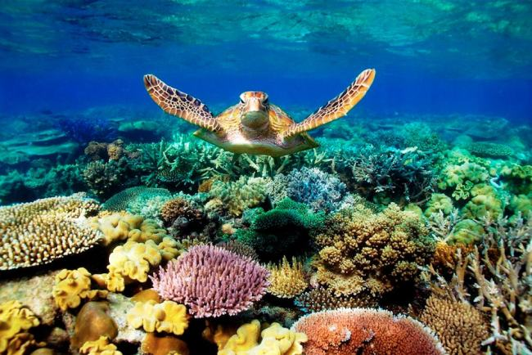
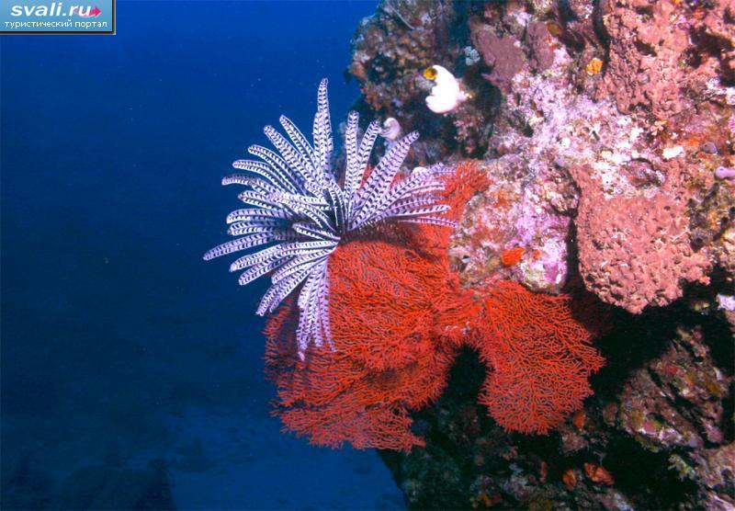
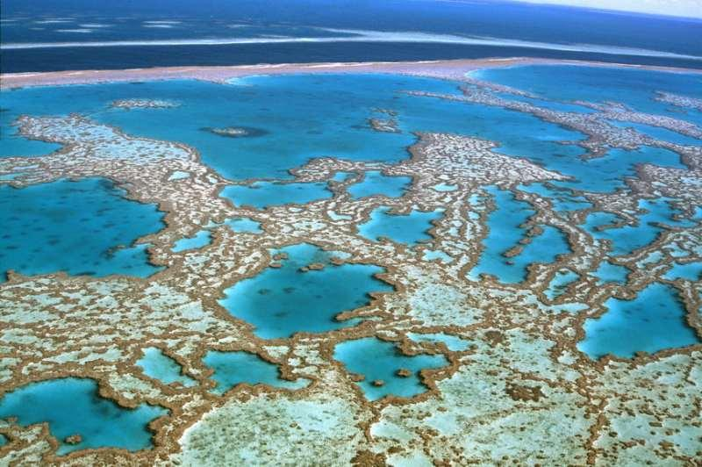
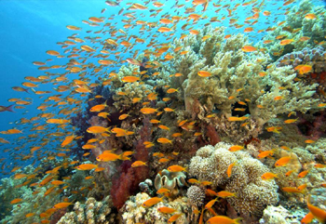
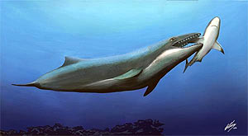
Great Barrier Reef
It’s the world’s largest coral reef (over 2000 km). It stretches along the east coast of Queensland. It’s made up of over 2900 individual
reefs very close
to each other.

Slide 13
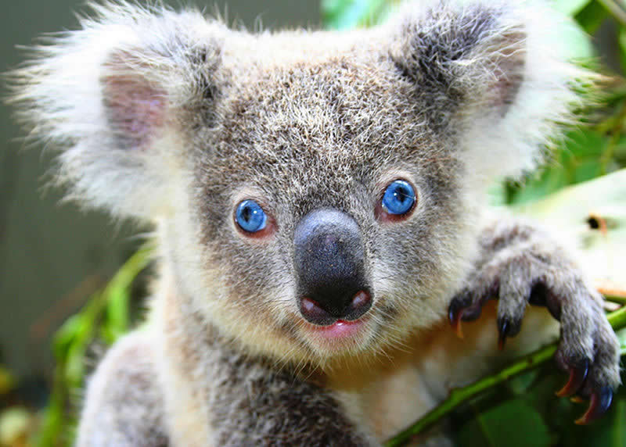
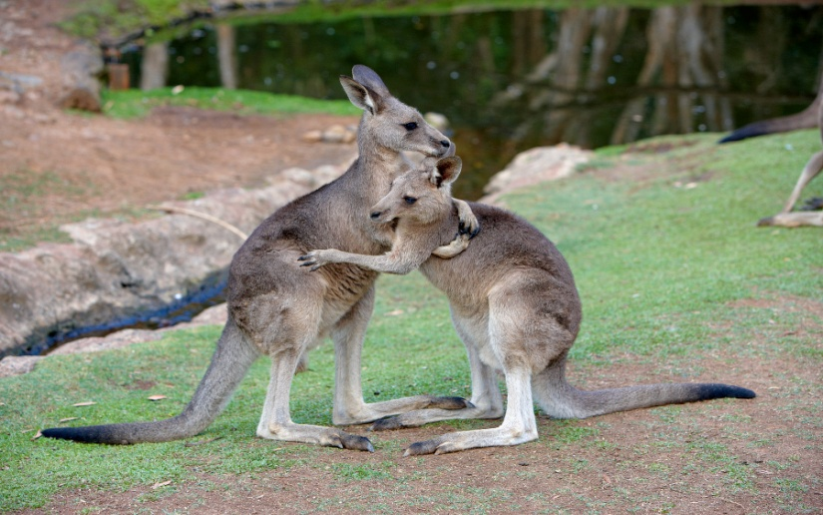
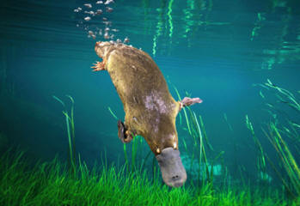
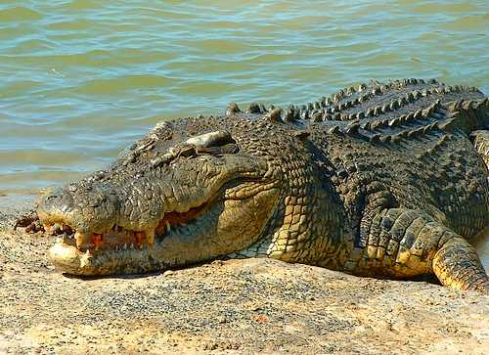
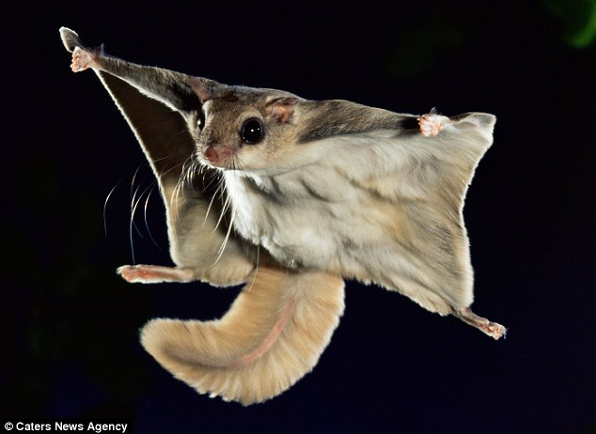
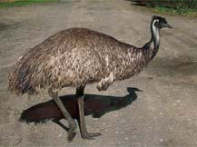
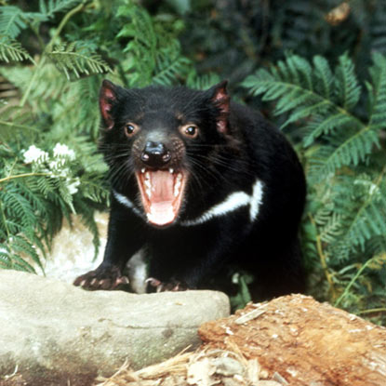
Wildlife of Australia
The fauna of Australia consists of a huge variety of animals; some 83% of mammals, 89% of reptiles, 24% of fish and insects and 93% of amphibians that inhabit the continent are endemic to Australia

Slide 14
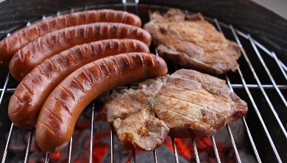
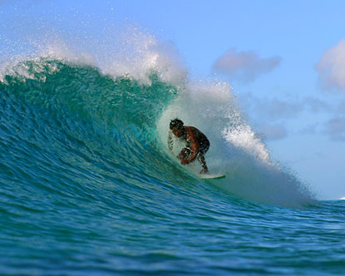
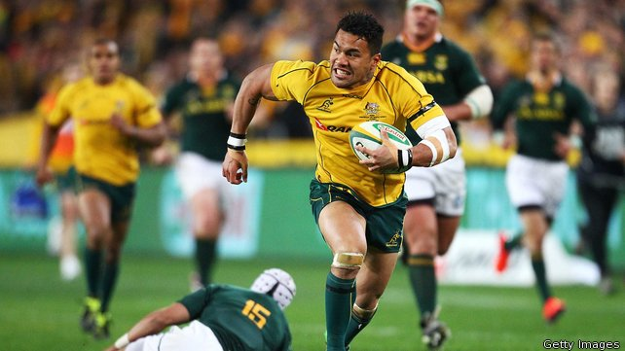
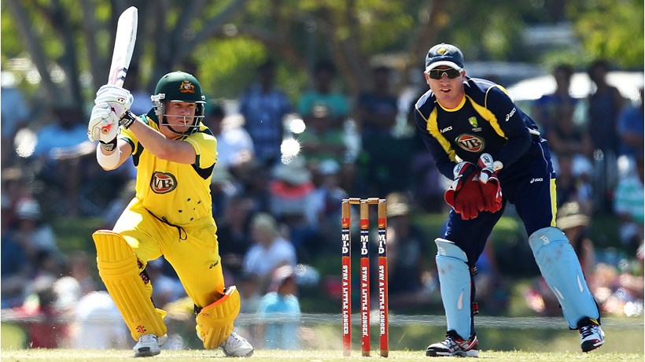
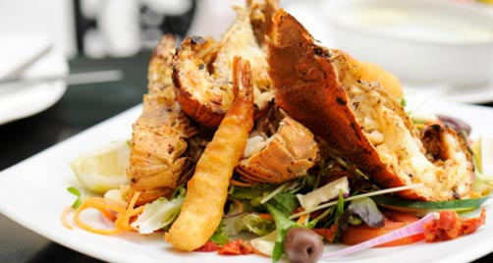
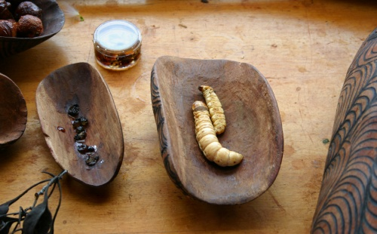
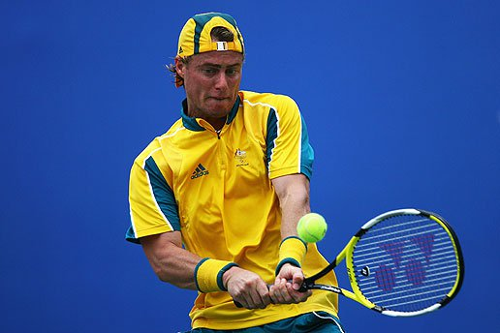
Food and Sports

Slide 15
The End

