Slide 1
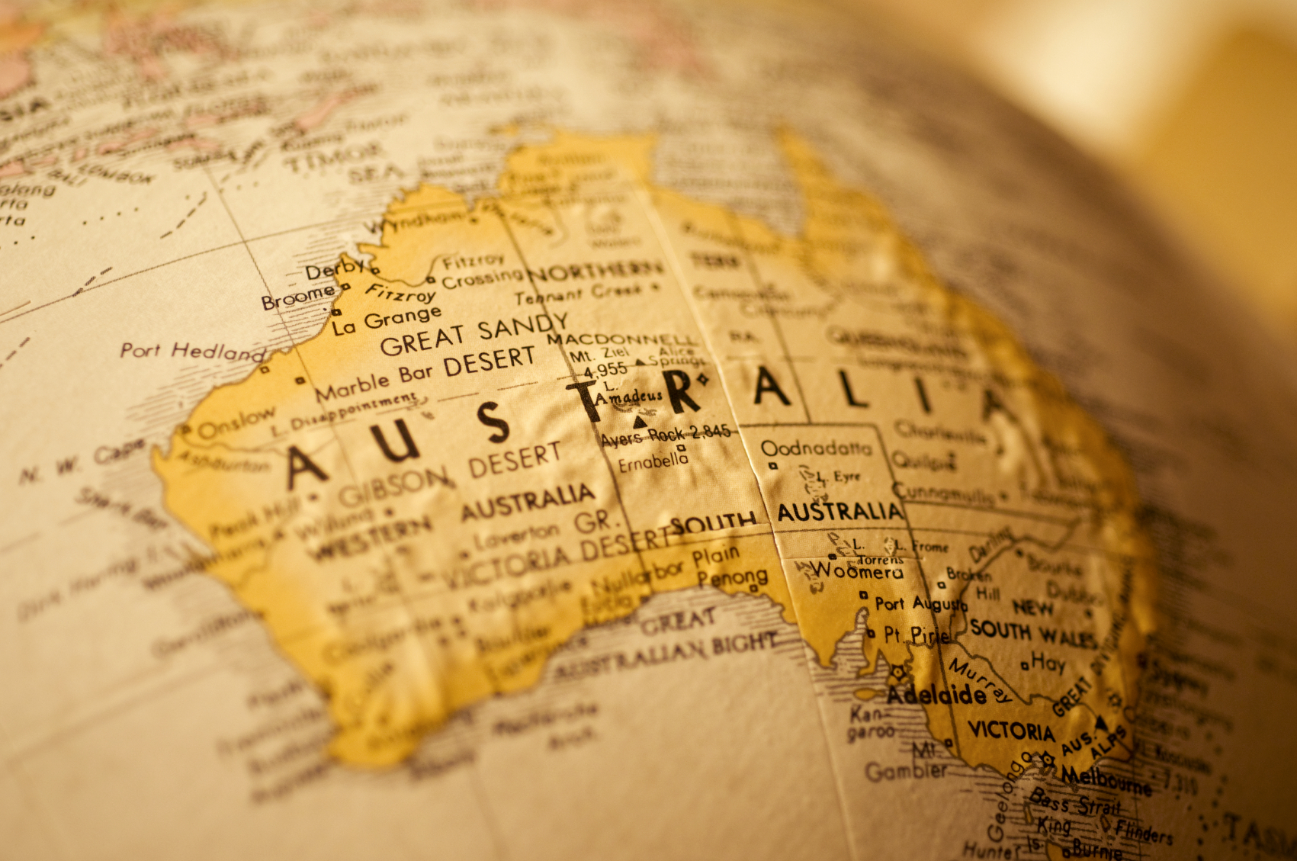

Slide 2
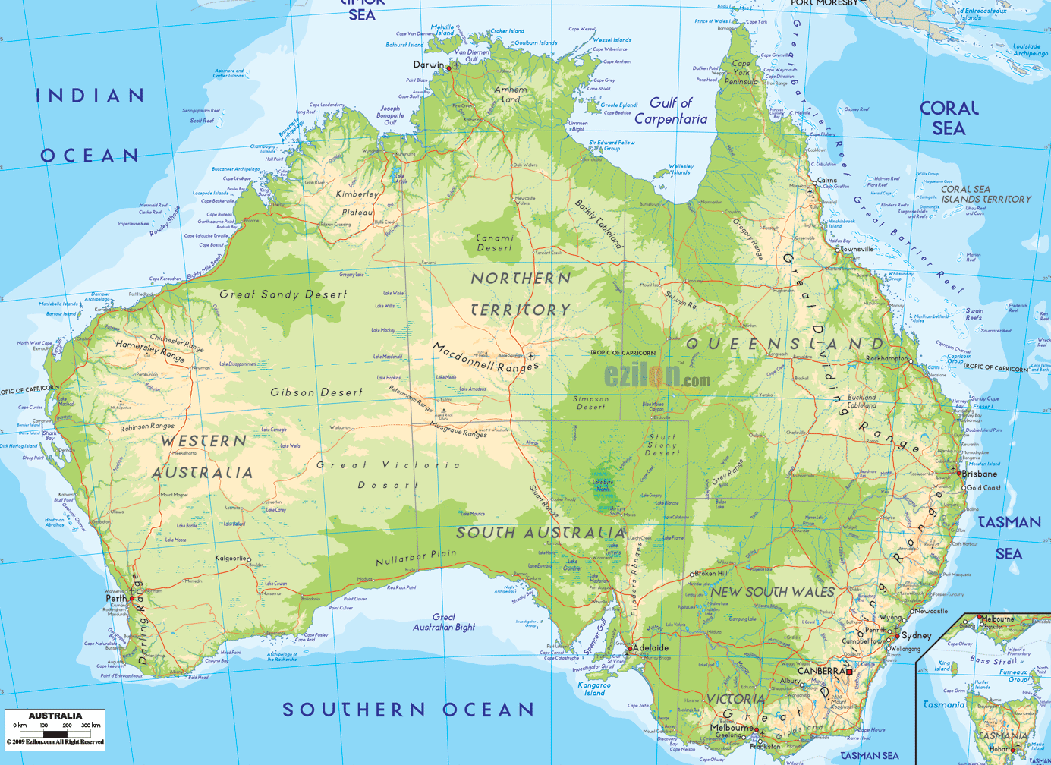
Australia
Australia officially the Commonwealth of Australia, is an Oceanian country comprising the mainland of the Australian continent, the island of Tasmania, and numerous smaller islands. It is the world's sixth-largest country by total area. Neighbouring countries include Indonesia, East Timor and Papua New Guinea to the north; the Solomon Islands and Vanuatu to the north-east; and New Zealand to the south-east

Slide 3
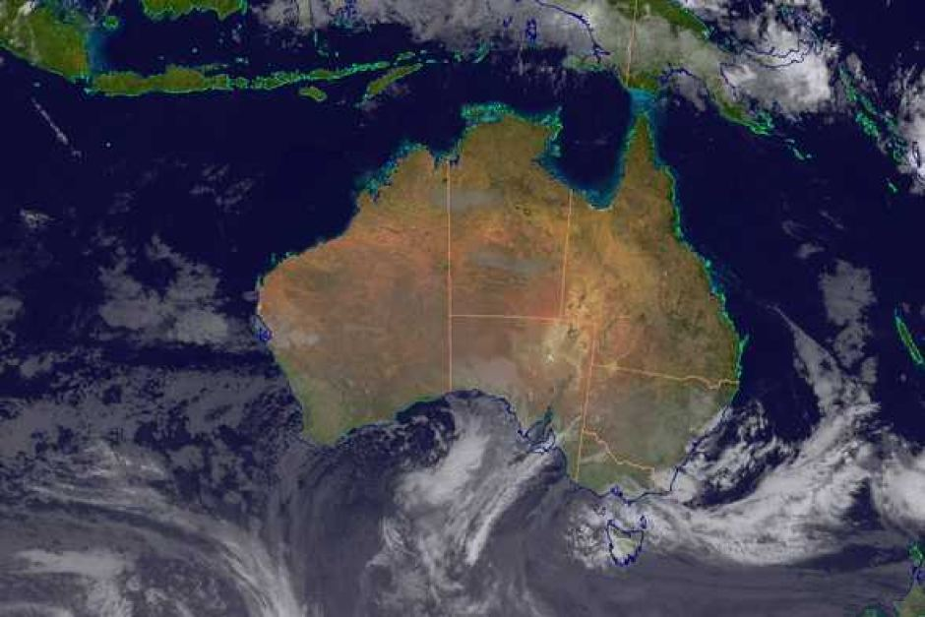
Weather
temperate weather for most of the year but the climate can vary due to the size of our continent. The northern states typically experience warm weather much of the time, with the southern states experiencing cooler winters. Australia is also one of the driest continents on earth with an average rainfall of less than 600 milimetres. Like all countries in the southern hemisphere, Australia's seasons are opposite to those in the northern hemisphere. December to February is summer; March to May is autumn; June to August is winter; and September to November is spring.

Slide 4
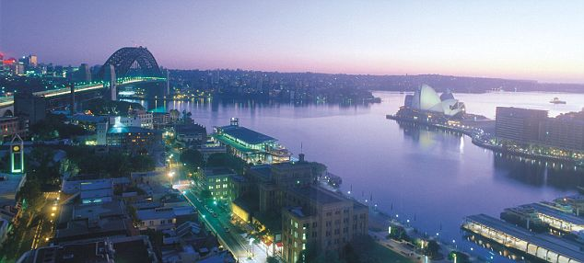
Seasons
Australia is a country for all seasons. You can do practically anything here, at any time of year. There are four seasons across most of the country and a wet and dry season in our tropical north.
Summer in Australia, from December to February, is a great time to get outdoors. Swim Sydney’s beaches or hike Tasmania’s Overland Track. March to May heralds Australia’s autumn, a season of fiery foliage in Canberra and the Formula 1 Grand Prix in Melbourne. Australia’s winter, from June to August, offers snow skiing in the Australian Alps. Alternatively, take a winter sun holiday. Snorkel in the temperate Great Barrier Reef or 4WD through South Australia’s Simpson Desert. Spring in Australia, from September to November is the time to watch for whales and wildflowers as you explore the wineries of Western Australia’s Margaret River region.
In tropical Australia, the dry season from May to October has clear blue skies and sunny days. It’s the time to experience Darwin’s vibrant outdoor markets, movies and festivals. December to March is the wet season, which is hot and humid with daily rainstorms. See waterfalls thunder through Litchfield and Kakadu National Parks or fly over Katherine Gorge when its water levels are highest.

Slide 5
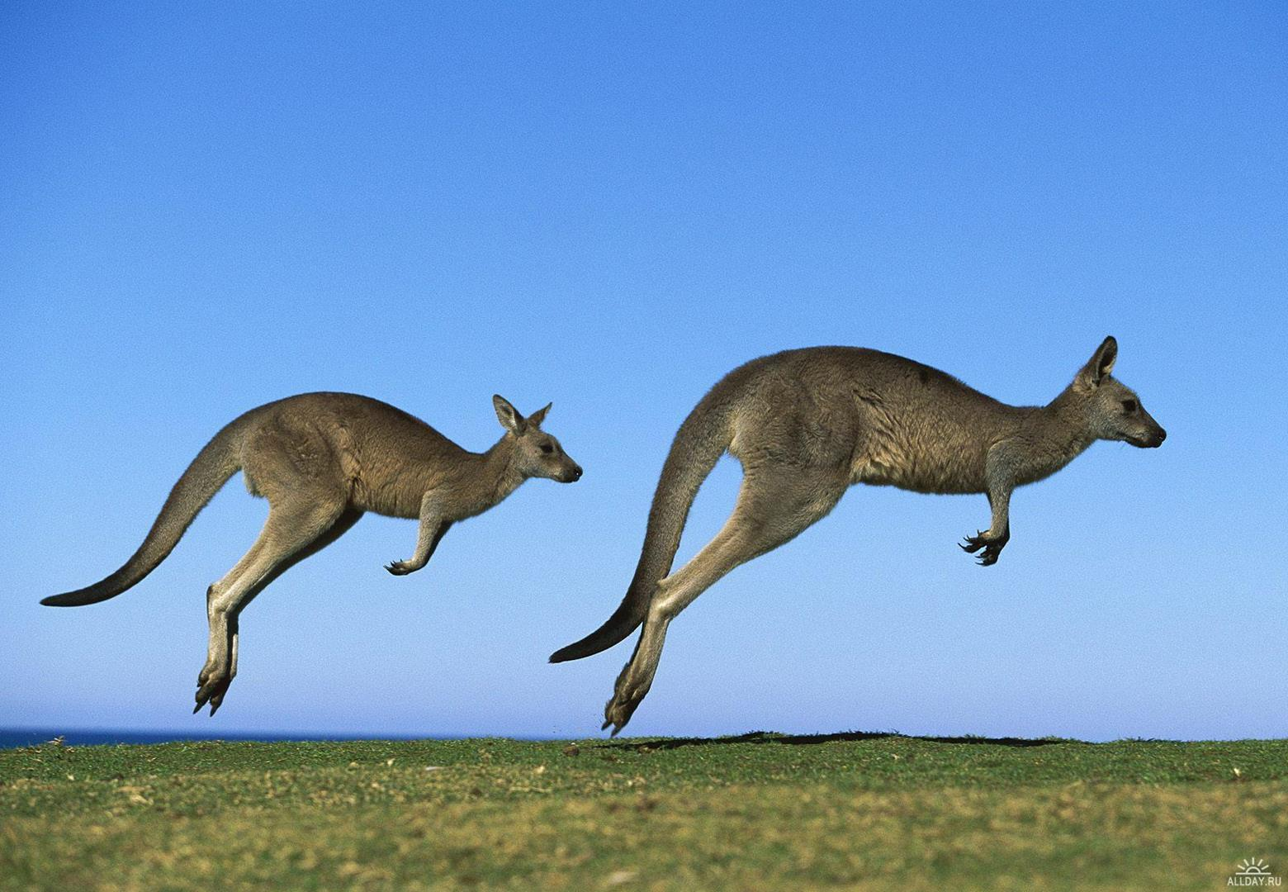
Famous Animals
Australia has more than 140 species of marsupials, including kangaroos, wallabies, koalas, and wombats.
We have 55 different native species of kangaroos and wallabies. Kangaroos and wallabies vary greatly in size and weight, ranging from half a kilogram to 90 kilograms. The main difference between them is size — wallabies tend to be smaller

Slide 6
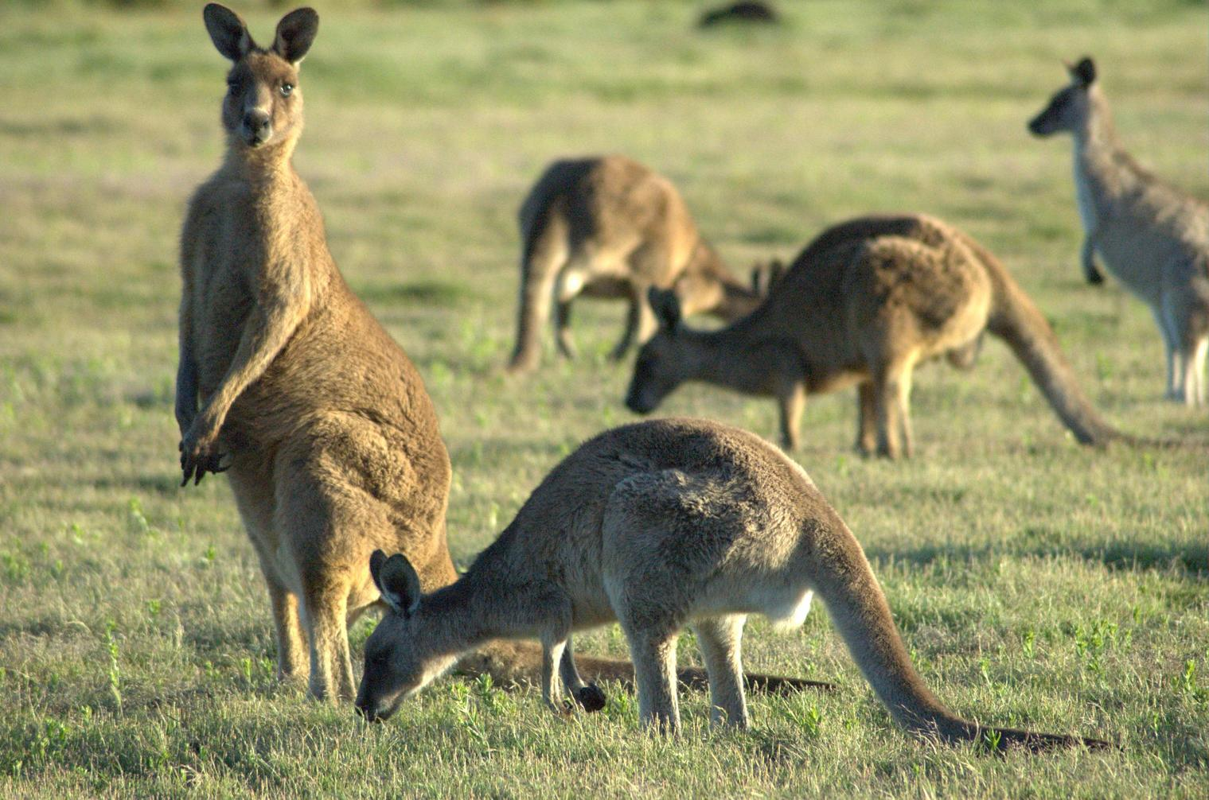
Kangaroos
The kangaroo is a marsupial from the family Macropodidae (macropods, meaning 'large foot'). In common use the term is used to describe the largest species from this family, especially those of the genus Macropus: the red kangaroo, antilopine kangaroo, eastern grey kangaroo and western grey kangaroo. Kangaroos are endemic to Australia, and one genus, the tree-kangaroo, is also found in Papua New Guinea. The Australian government estimates that 34.3 million kangaroos lived in Australia in 2011, up from 25.1 million one year earlier

Slide 7
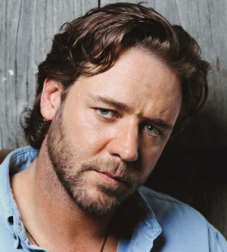
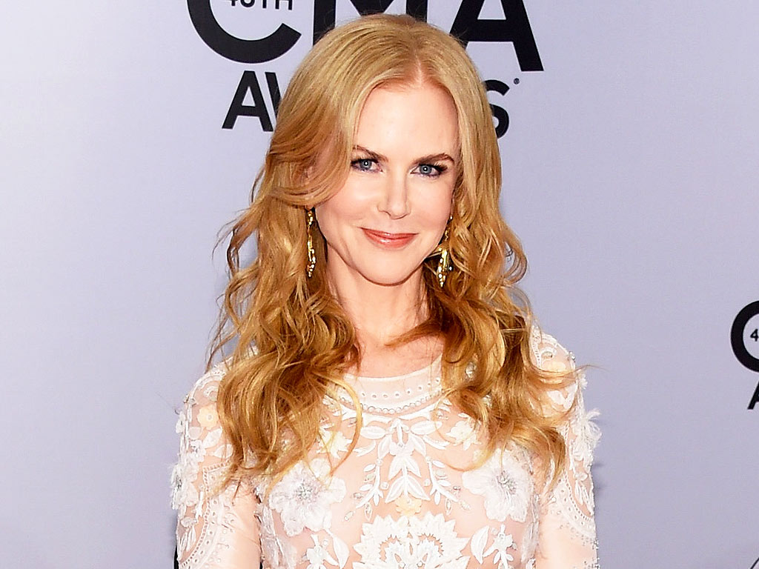
Famous people

Slide 8
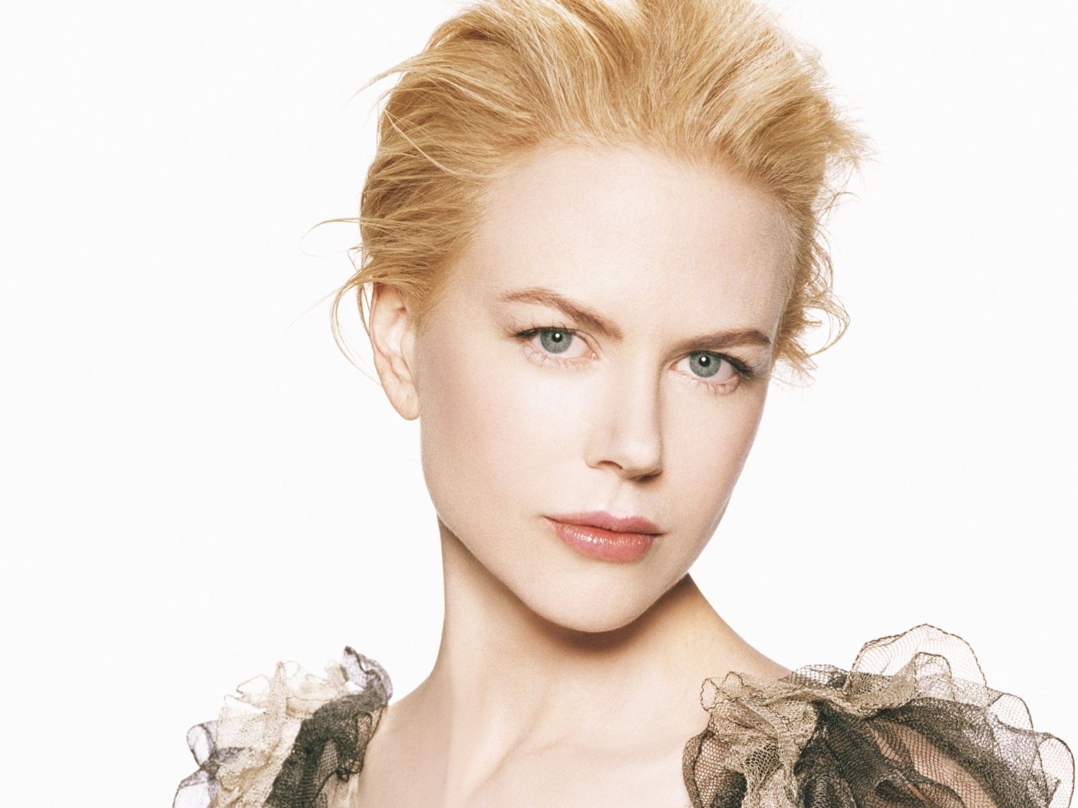
Nicole Kidman
Nicole Mary Kidman, (born 20 June 1967) is an Australian actress and film producer.
Kidman's breakthrough film role was in the 1989 thriller Dead Calm. After appearing in several films in the early 1990s, she came to worldwide recognition for her performances in the auto racing film Days of Thunder (1990), the romance Far and Away (1992), and the superhero film Batman Forever (1995). Other successful films followed in the late 1990s. Her performance in the musical Moulin Rouge! (2001) earned her a second Golden Globe Award and first Academy Award nomination for Best Actress

Slide 9
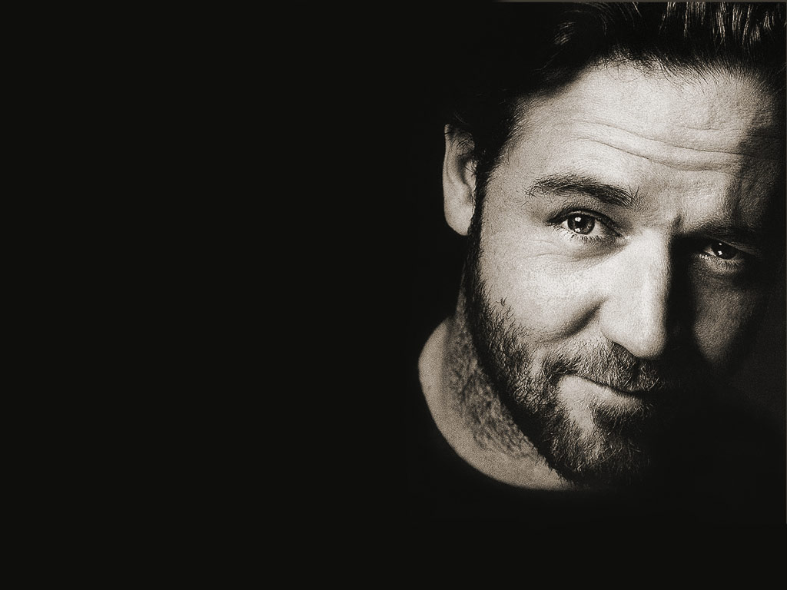
Russel Crowe
Russell Ira Crowe (born 7 April 1964) is an actor, film producer and musician. Although a New Zealand citizen, he has lived most of his life in Australia and identifies himself as an Australian. He came to international attention for his role as the Roman General Maximus Decimus Meridius in the 2000 historical epic film Gladiator, directed by Ridley Scott, for which Crowe won an Academy Award for Best Actor, a Broadcast Film Critics Association Award for Best Actor, an Empire Award for Best Actor and a London Film Critics Circle Award for Best Actor and 10 further nominations for best actor.

Slide 10
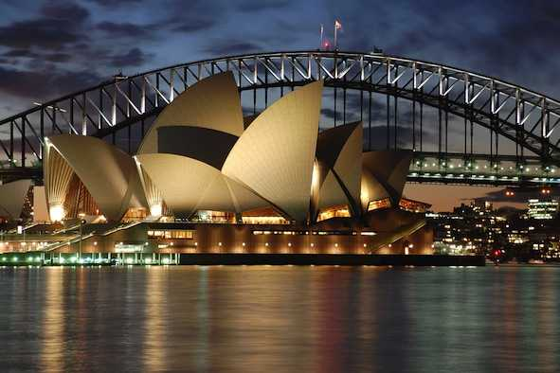
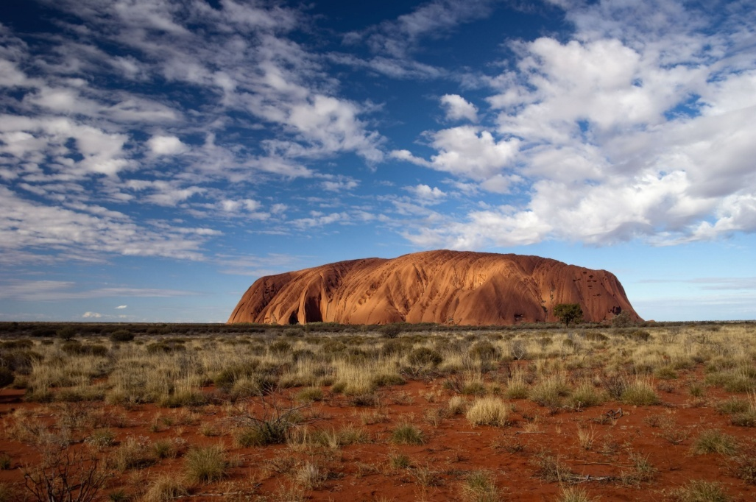
Famous Places

Slide 11
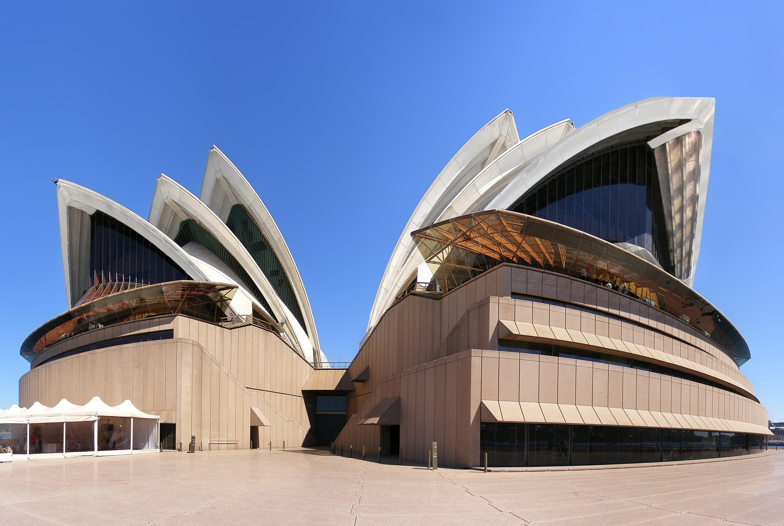
Sydney Opera House
The Sydney Opera House is a multi-venue performing arts centre in Sydney, New South Wales, Australia. Situated on Bennelong Point in Sydney Harbour, close to the Sydney Harbour Bridge, the facility is adjacent to the Sydney central business district and the Royal Botanic Gardens, between Sydney and Farm Coves. Identified as one of the 20th century's most distinctive buildings and one of the most famous performing arts centres in the world,[the facility is managed by the Sydney Opera House Trust, under the auspices of the New South Wales Ministry of the Arts.

Slide 12

Uluru
Uluru also known as Ayers Rock and officially gazetted as Uluru / Ayers Rock, is a large sandstone rock formation in the southern part of the Northern Territory in central Australia. It lies 335 km (208 mi) south west of the nearest large town, Alice Springs, 450 km (280 mi) by road.
Kata Tjuta and Uluru are the two major features of the Uluṟu-Kata Tjuṯa National Park. Uluru is sacred to the Anangu, the Aboriginal people of the area. The area around the formation is home to a plethora of springs, waterholes, rock caves, and ancient paintings. Uluru is listed as a UNESCO World Heritage Site.

